Slide 1
Kerstin-Anja Münderlein
Gender, Sex and Queerness in Cultural Studies

Slide 2
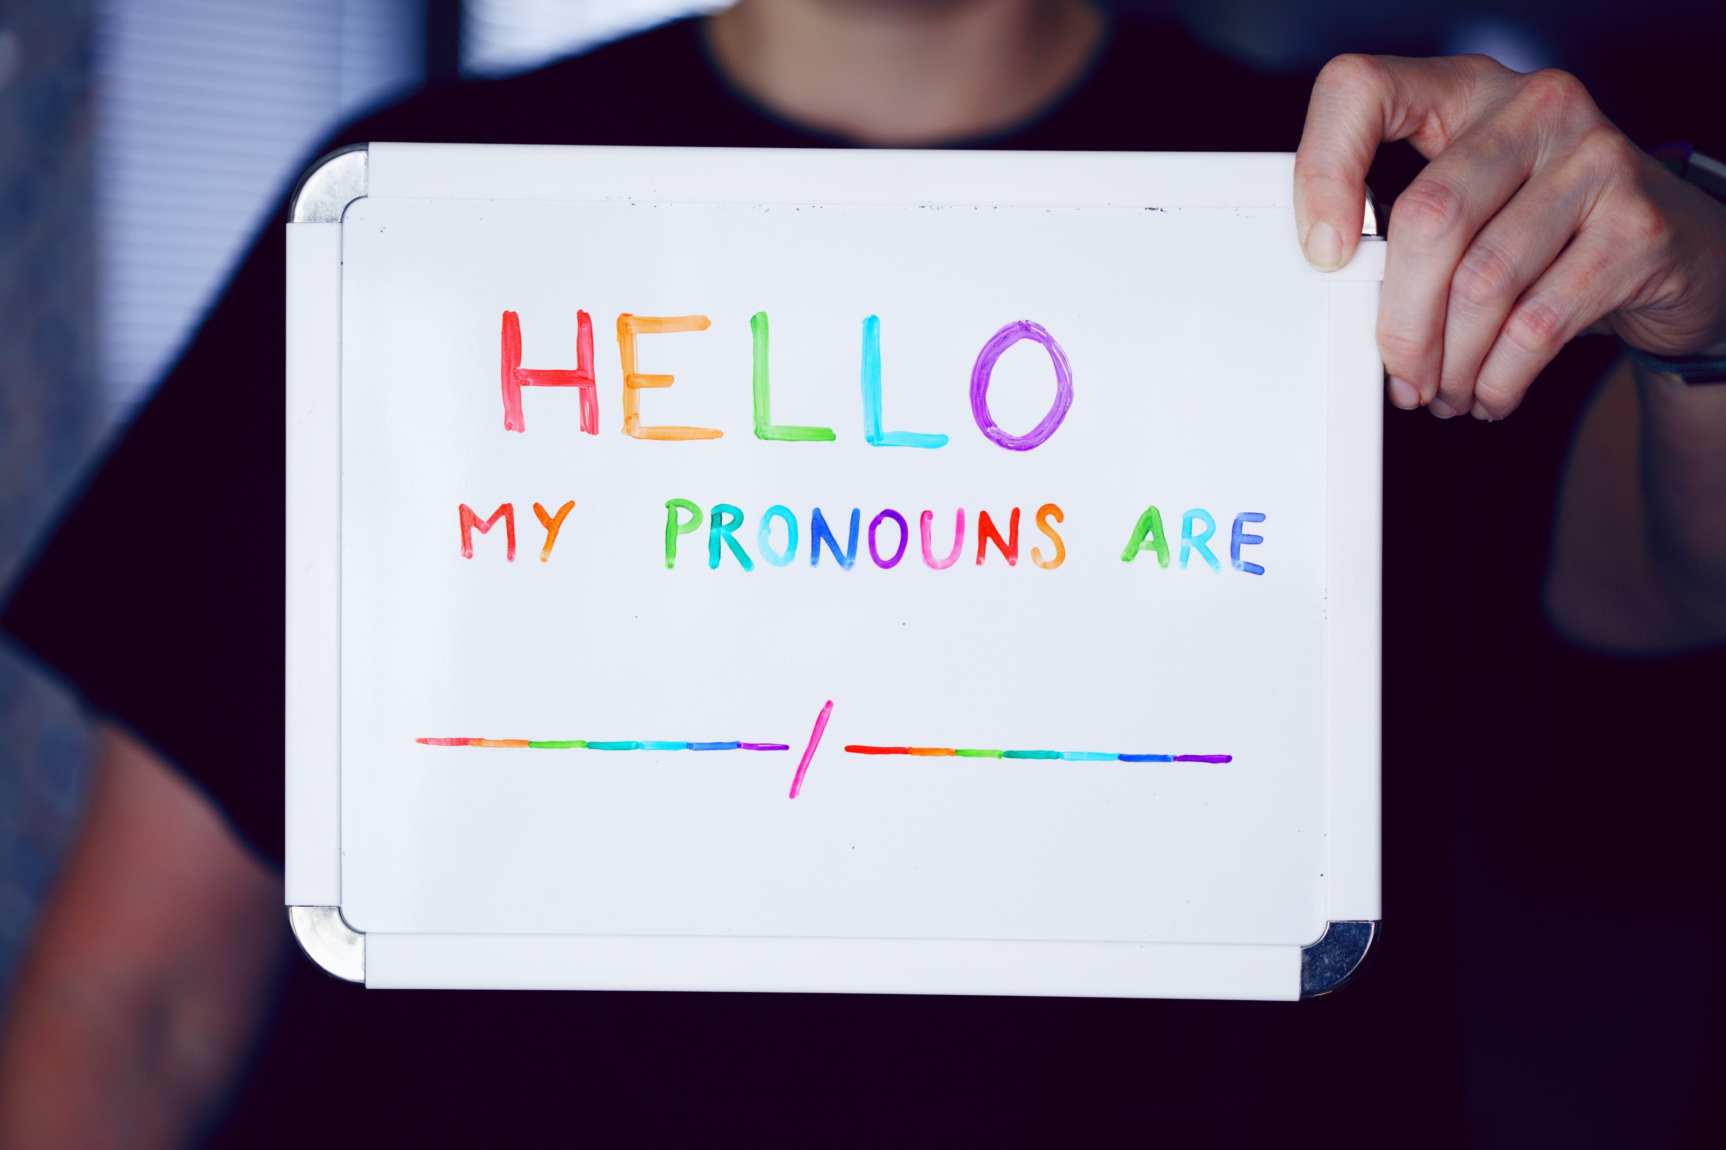
Queer as folk…?
picture by Alexander Grey on Unsplash

Slide 3
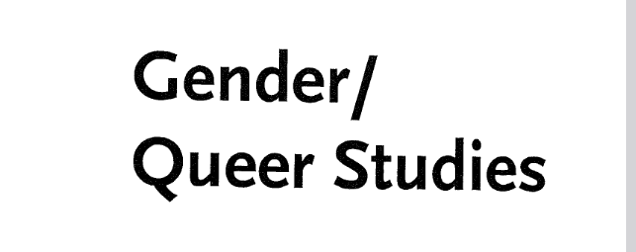
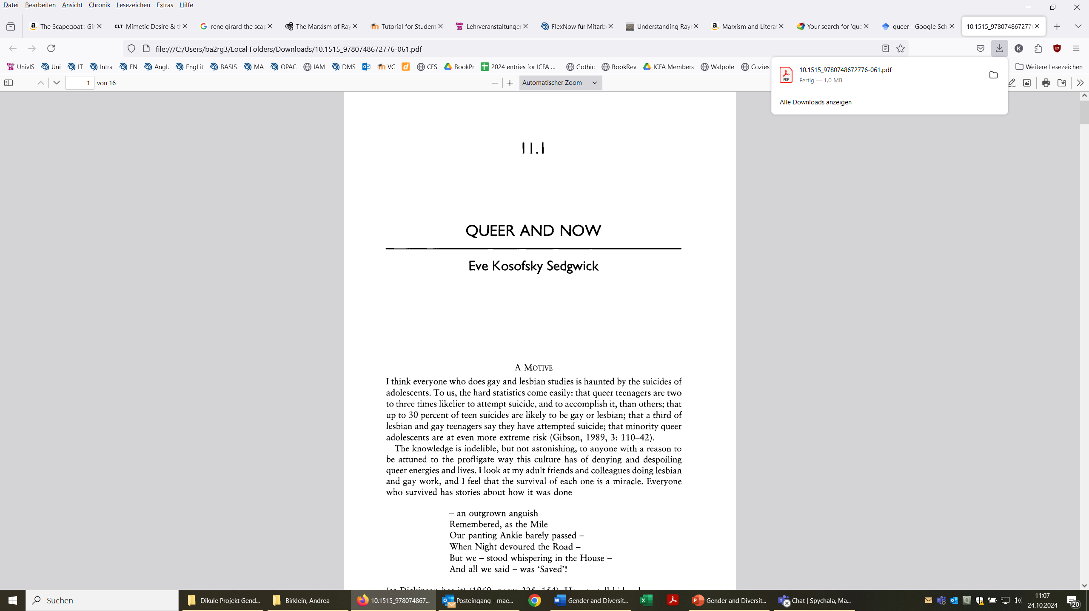
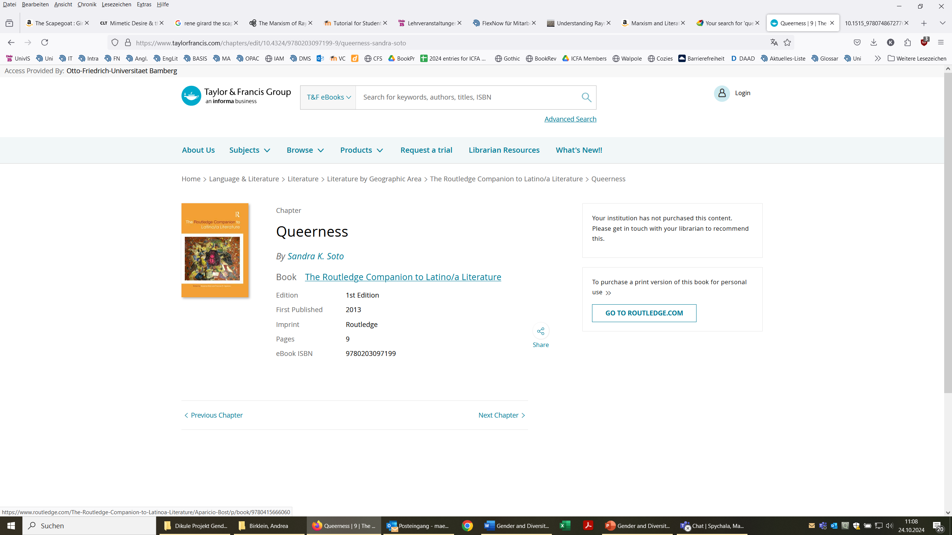
Queer as folk…? 2

Slide 4

Notation “queer”
quere?
queyr?
queere?
queir?
queer?
quere?

Slide 5
Defining “queer”
“Of a person: having a sexual or gender identity that does not correspond to, or that challenges, traditional (esp. heteronormative) ideas of sexuality or gender.”
(OED, “queer” 3b)

Slide 6
Defining “queer” 2
“of, relating to, or characterized by sexual or romantic attraction that is not limited to people of a particular gender identity or sexual orientation” and
“of, relating to, or being a person whose sexual orientation is not heterosexual and/or whose gender identity is not cisgender”
(Merriam-Webster, “queer” 2b and 2c)

Slide 7
Derogatory terms throughout history
“Sinner”
“Faggot”
“Homo”
Derogatory terms throughout history
“Pervert”
“Trans/queer
agenda”

Slide 8
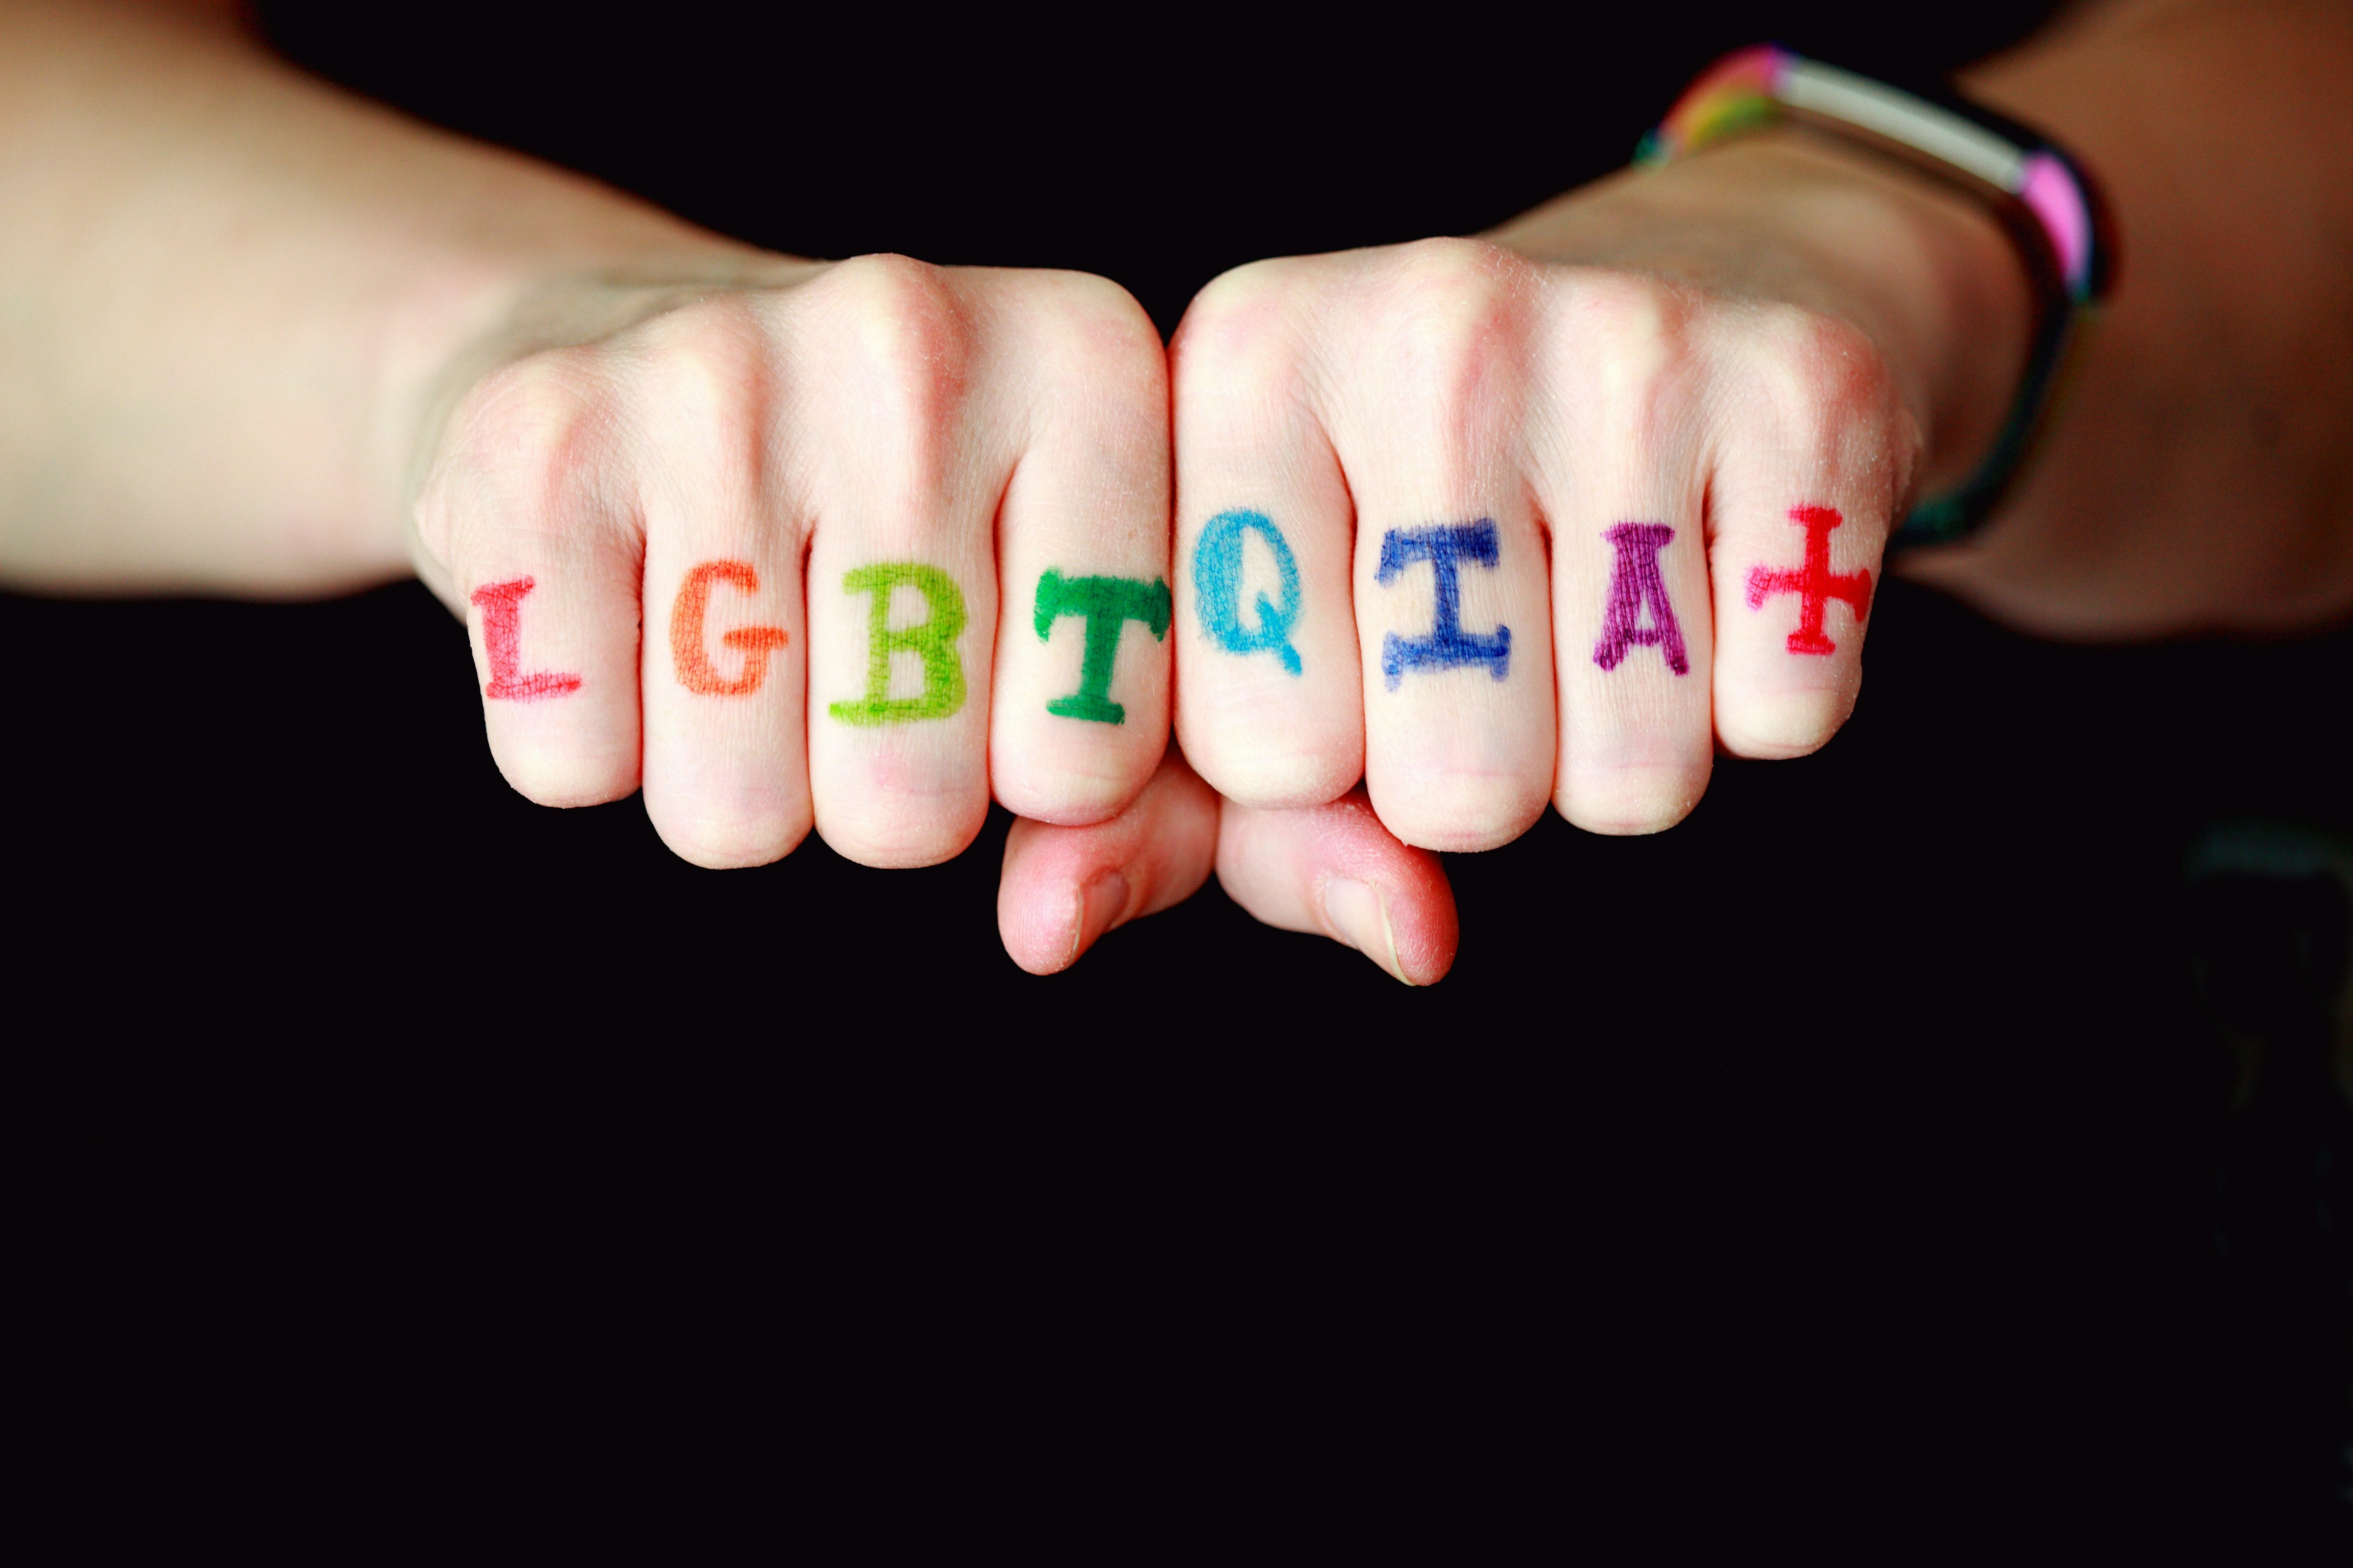
A bit of terminology
picture by Alexander Grey on Unsplash

Slide 9
LGBTQIA+
Lesbian
Gay
Bisexual
Trans
LGBTQIA+
Queer
Intersex
Asexual
+ more

Slide 10
Sex vs. gender
Sex
Biological sex a person is born with; long believed to be either male or female with rare exceptions
Gender
Socially coined and individually learned roles based upon social assumptions of biological sex

Slide 11
Cisgender/cis
Cisgender/cis

Slide 12
Transgender/ trans
Transgender/trans
“describing people whose gender identity is different from cultural expectations based on the sex they were assigned at birth”
(Center for Inclusion and Social Change)

Slide 13

Transgender pride flag

Slide 14
Literature
Dawson, Juno. Gender Games: The Problem With Men and Women, From Someone Who Has Been Both. Hodder & Stoughton, 2017.
Raines, Jamie. The T in LGBT+: Everything You Need to Know About Being Trans. Vermillion, 2023.

Slide 15
Nonbinary/ Non-binary
Nonbinary/
Non-binary
“The term ‘nonbinary’ [… is] used to describe someone whose gender identity can’t be described as exclusively woman or man.
Some people who are nonbinary experience their gender as both man and woman, and others experience their gender as neither man nor woman.”
(Abrams and Ferguson 2023, n. pag.)

Slide 16

Nonbinary flag

Slide 17
Literature 2
Oseman, Alice. Heartstopper. Hachette Children‘s Group, 2019-present.
Euros Lyn, dir. Heartstopper. 3 seasons. Created by Alice Oseman. Aired April 22, 2022 on Netflix.
"6 Cultures That Recognize More than Two Genders." (Encyclopedia Britannica)

Slide 18
some more gender terms
Genderqueer
Genderfluid
Agender
Intersex

Slide 19

Genderqueer
Genderqueer
“reject notions of static categories of gender, embracing a fluidity of gender identity. People who identify as genderqueer may see themselves as being both men and women, as neither men nor women, or as falling completely outside the gender binary”
(Center for Inclusion and Social Change)

Slide 20

Genderfluid
Genderfluid
“a genderfluid person can identify as any gender, or any combination of genders at any given time.”
(Center for Inclusion and Social Change)

Slide 21

Agender
Agender
“Agender is an identity in which people do not identify with any gender, existing completely outside of the gender spectrum.”
(Center for Inclusion and Social Change)

Slide 22

Intersex
Intersex
“Intersex is an umbrella term that describes a wide range of natural physical variations that do not fit into conventional definitions of male or female. Intersex variations include variations in chromosomes, hormone balance, and external and internal characteristics.”
(Center for Inclusion and Social Change)

Slide 23
Sexuality
Sexuality
A person‘s sexual attraction or orientation

Slide 24


Lesbian and Gay
Lesbian
Gay

Slide 25


Bi(sexual) and Pan(sexual)
Bi(sexual)
Pan(sexual)

Slide 26


Omnisexual and Asexual/Ace
Omnisexual
Asexual/Ace

Slide 27
Asexual/Ace
aromantic/aro = people who feel no romantic attraction to other people
Oseman, Alice. Heartstopper. Hachette Children‘s Group, 2019-present.
Asexual/Ace

Slide 28

discussion of genders and sexuality
picture by Volodymyr Hryshchenko on Unsplash

Slide 29
Scapegoats and Sexuality: Gender, Diversity, and the Making of the 'Other' in Political Discourse 1
?

Slide 30
Scapegoats and Sexuality: Gender, Diversity, and the Making of the 'Other' in Political Discourse 2
The idea is that the object of mimetic imitation switches from the cycle of violence towards mimetically heaping blame upon a single target, arbitrarily chosen by the community. The individual may be selected because in some way they stand out as being different: perhaps they are an outsider, or are sick, or have a physical disability that marks them out. In any case they are a person whose death shall not be avenged. […] The victim is soon universally blamed for the crisis and hated for it. […] The group unanimously declares them guilty and collectively murders the victim.
(Keenan 2023, n. pag.)
Girard, René. The Scapegoat. Translated by Yvonne Freccero. Johns Hopkins UP, 1989.

Slide 31
Scapegoats and Sexuality: Gender, Diversity, and the Making of the 'Other' in Political Discourse 3
?

Slide 32
Quote: Marxism and Literature
“Williams […] introduces an incredibly useful set of concepts that convey the complex dynamism of cultural production: dominant, residual, and emergent. Culture is crisscrossed by varied forces, whether those forces are residual elements from the past still active in the present […]; emergent “new meanings and values, new practices, new relationships”[…]; or dominant mechanisms of incorporation and acceptance integral to class rule”
(Abu-Manneh 2022, n. pag.)
Williams, Raymond. Marxism and Literature. Oxford: Oxford UP, 1977. Specifically chapter II.8: „Dominant, Residual, and Emergent“

Slide 33
Including more diversity on medial representation 1

Slide 34
Including more diversity on medial representation 2

Slide 35
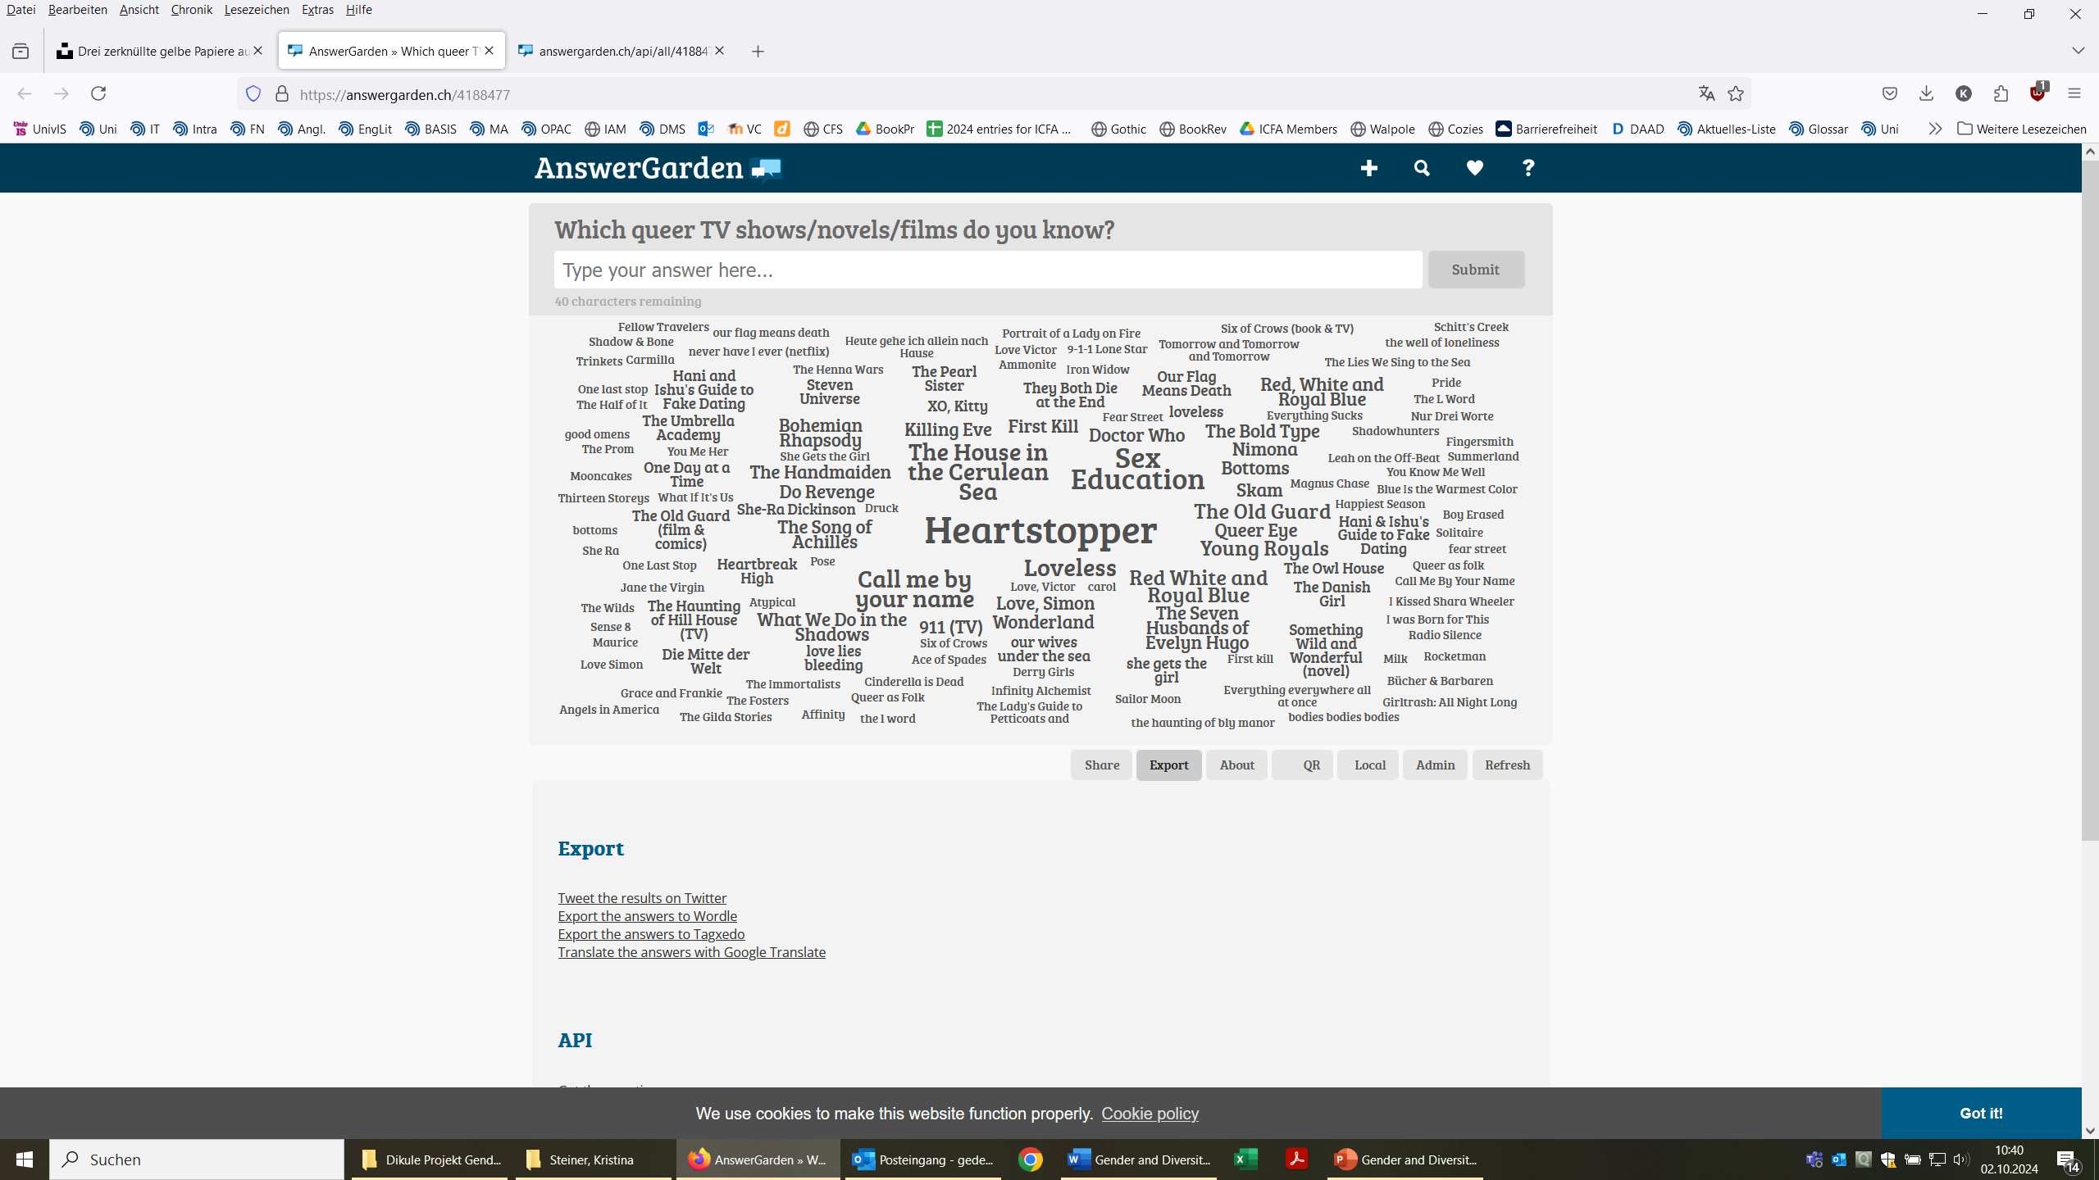
Heartstopper 2

Slide 36
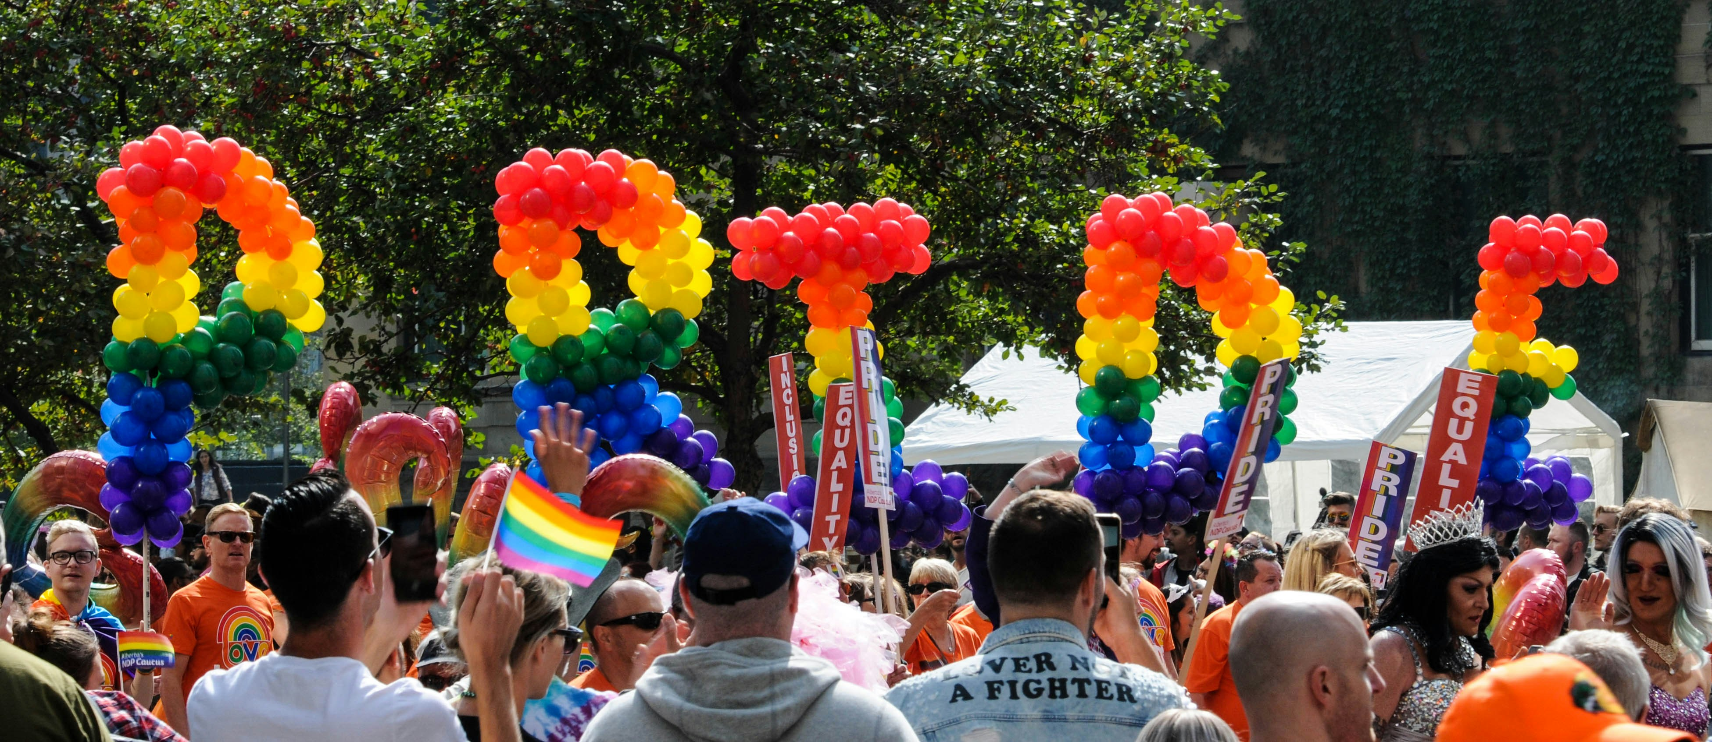
queer representation and recognition
picture by Toni Reed on Unsplash

Slide 37

Inter*Inclusive Pride Flag

Slide 38
References
Abrams, Mere, LCSW, and Sian Ferguson “Understanding What It Means to Be Nonbinary.” Healthline. June 26, 2023. https://www.healthline.com/health/nonbinary.
Bundesministerium für wirtschaftliche Zusammenarbeit und Entwicklung. “Gender.” Accessed September 30, 2024. https://www.bmz.de/de/service/lexikon/gender-14414.
Center for Inclusion and Social Change. “Pride Flag Guide.” Accessed September 30, 2024. https://www.colorado.edu/cisc/pride-flag-guide.
Abu-Manneh, Bashir. “The Marxism of Raymond Williams.” Catalyst, November 24, 2022. https://catalyst-journal.com/2022/11/the-marxism-of-raymond-williams.
Clancy, Kate, Agustin Fuentes, Caroline Vansickle, and Catherine Clune-Taylor. “Biology Is Not Binary.” American Scientist, March 2024. https://www.americanscientist.org/article/biology-is-not-binary.
Fuentes, Agustín. “Here’s Why Human Sex Is Not Binary.” Scientific American, May 1, 2023. https://www.scientificamerican.com/article/heres-why-human-sex-is-not-binary/.
Keenan, Bernard. “Mimetic Desire & the Scapegoat: Notes on the Thought of René Girard.” Critical Legal Thinking, September 4, 2023. https://criticallegalthinking.com/2023/09/04/mimetic-desire-the-scapegoat-notes-on-the-thought-of-rene-girard/.
Merriam-Webster.com Dictionary, s.v. “queer,” accessed September 27, 2024, https://www.merriam-webster.com/dictionary/queer.
Oxford English Dictionary, s.v. “queer (adj.1),” June 2024, https://doi.org/10.1093/OED/9610104456.
Raines, Ramie. The T in LGBT+. Everything You Need to Know About Being Trans. London: Vermillion, 2023.
Urban Dictionary, s.v. “queer,” accessed September 30, 2024, https://www.urbandictionary.com/define.php?term=queer.

Slide 39
Impressum
Kerstin-Anja Münderlein/University of Bamberg, CC BY 4.0
This contribution is part of the multimedia series #Diversitäten of the ‘Culture and Education’ department of the Bamberg Centre for Teacher Education.
It was created as part of the project ‘DiKuLe: Developing Digital Teaching Cultures’ at the Otto Friedrich University of Bamberg, funded by the Stiftung Innovation in der Hochschullehre.
Project leaders/editors of the contribution series: Adrianna Hlukhovych, Dominik Herrmann, Konstantin Lindner, Sabine Vogt.
2025

