Slide 1
Migration and the Labour Market
STATA: An Introduction into the Basics
Prof. Dr. Herbert Brücker
Bamberg, June 1/June 22, 2017

Slide 2
Migration and the Labor Market Session 3: STATA: An Introduction into the Basics
Contents
I What do we have to do for the paper
II Brief introduction into the datasets
III Introduction into STATA
STATA Software Package
STATA Basics: three files
Getting started
The STATA Menues
The Grammar of STATA
Working with Do-Files
Organizing your session
Processing your data
Describe your data
Making graphs

Slide 3
Migration and the Labor Market Session 3: STATA: An Introduction into the Basics
I What do we have to do for the paper?
State of research (brief literature review)
Defining the question
Wage effects of immigration
Employment effects
Preparing the dataset
Generating Dummy Variables
Generating/Transforming other Variables
Describing the data
Data sources
Descriptive statistics
Graphs
Running simple regression models
Presentation in class and drafting the paper

Slide 4
Migration and the Labor Market Session 3: STATA: An Introduction into the Basics
Recall the Borjas (2003)-Modell
where
y_{ijt} is the dependent variable (e.g. log wage, unemployment rate)
s_{i} is an education dummy
x_{j} is an work experience dummy
π_{t} is a time dummy
plus many interaction dummies
This is what we want to estimate. For this we need certain tools, inter alia STATA knowledge.

Slide 5
Migration and the Labor Market Session 3: STATA: An Introduction into the Basics
A brief intro into the data

Slide 6
Migration and the Labor Market Session 3: STATA: An Introduction into the Basics
What is important to know about the data
The data are derived from micro data (cumbersome)
Denmark: IDA register data (social security data)
whole universe of the population
Germany: IEB register data (social security records)
5% sample
UK: Labour Force Survey data
0,5-1% sample of population
Differences
Country of birth (DK, UK), nationality and past nationality (DE)
Education: degrees (DE and DK), years of schooling (UK) due to educational systems
Many, many details

Slide 7
Migration and the Labor Market Session 3: STATA: An Introduction into the Basics
What is important to know about the data
Literature reference:
Brücker, Herbert; Hauptmann, Andreas, Jahn, Elke, Upward, Richard (2014), “Migration and imperfect labour markets. Theory and cross-country evidence from Denmark, Germany and the UK”, in: European Economic Review, Vol. 66, pp. 205-225.

Slide 8
Migration and the Labor Market Session 3: STATA: An Introduction into the Basics
How have we organized the datafile?
Year: 19XX to 20XX
Education: 3 groups by degree (DE, DK) or years of schooling (UK)
Experience: 4 groups by work experience (0-5, 6- 10, 11-20, over 20)
Hsumwage: Wagesum of native workers (LHt*wht)
Fsumwage: Wagesum of immigrant workers (LFt*wft)
LHqjt: Number of workers by nationality, education, workexperience and year
UHqjt: Number of unemployed workers by nationality, education and workexperience and year
NHqjt: Labour force (L+U) by nationality, education, work experience and year

Slide 9
Migration and the Labor Market Session 3: STATA: An Introduction into the Basics
How have we organized the datafile?
wHqjt: wage of workers by nationality, education, workexperience and year
wHqt: mean wage aggregate by nationality and education and year
wHt: mean wage aggregate by nationality and year
wt mean wage aggregate by year
Same for L, U, and N
Indices:
H, F: Natives, Immigrants
q: education
j: work experience
t: time (year)

Slide 10
Migration and the Labor Market Session 3: STATA: An Introduction into the Basics
Working with STATA: Introduction into the Basics

Slide 11
Migration and the Labor Market Session 3: STATA: An Introduction into the Basics
Best STATA textbook in German:
Ulrich Kohler / Frauke Kreuter: Datananalyse mit STATA: allgemeine Konzeote der Datenanalyse und ihre praktische Anwendung, 4. Auflage, Oldenbourg Verlag.

Slide 12
Migration and the Labor Market Session 3: STATA: An Introduction into the Basics
1 STATA SOFTWARE PACKAGE
Connect to Bamberg University datanet via cable, WLAN or VPN
Switch to \\lizenz01.rz.uni-Bamberg.de\Stata_SoWi
Insert your username in format uni-Bamberg.de\BA-Kennung
Use START_Stata_SoWi button to start Software (doubleclick)
Note that this may need several minutes (usually 3-5 minutes)
Support: it-support@uni-Bamberg.de, fon: 0951 863-1333
Note: there only 50 licences. Close Stata if you don’t use it

Slide 13
Migration and the Labor Market Session 3: STATA: An Introduction into the Basics
Structure of STATA: Three files
The DATA file (.dta) where you have your data.
You can watch you data with the DATA BROWSER and edit your data with the DATA EDITOR
The DO file (.do) where you run and save your commands of any session. Very useful (i) to organise your data set, (ii) to see what you have done in the last session, (iii) to replicate what you have done in last session, (iv) to exchange work with your collaborators.
You write and run your commands with the DO FILE EDITOR

Slide 14
Structure of STATA: Three files
The LOG file (.scmf) which automatically reports all things which you have done during your session. Is automatically saved after your session. Useful if something goes wrong.
Migration and the Labor Market Session 3: STATA: An Introduction into the Basics

Slide 15
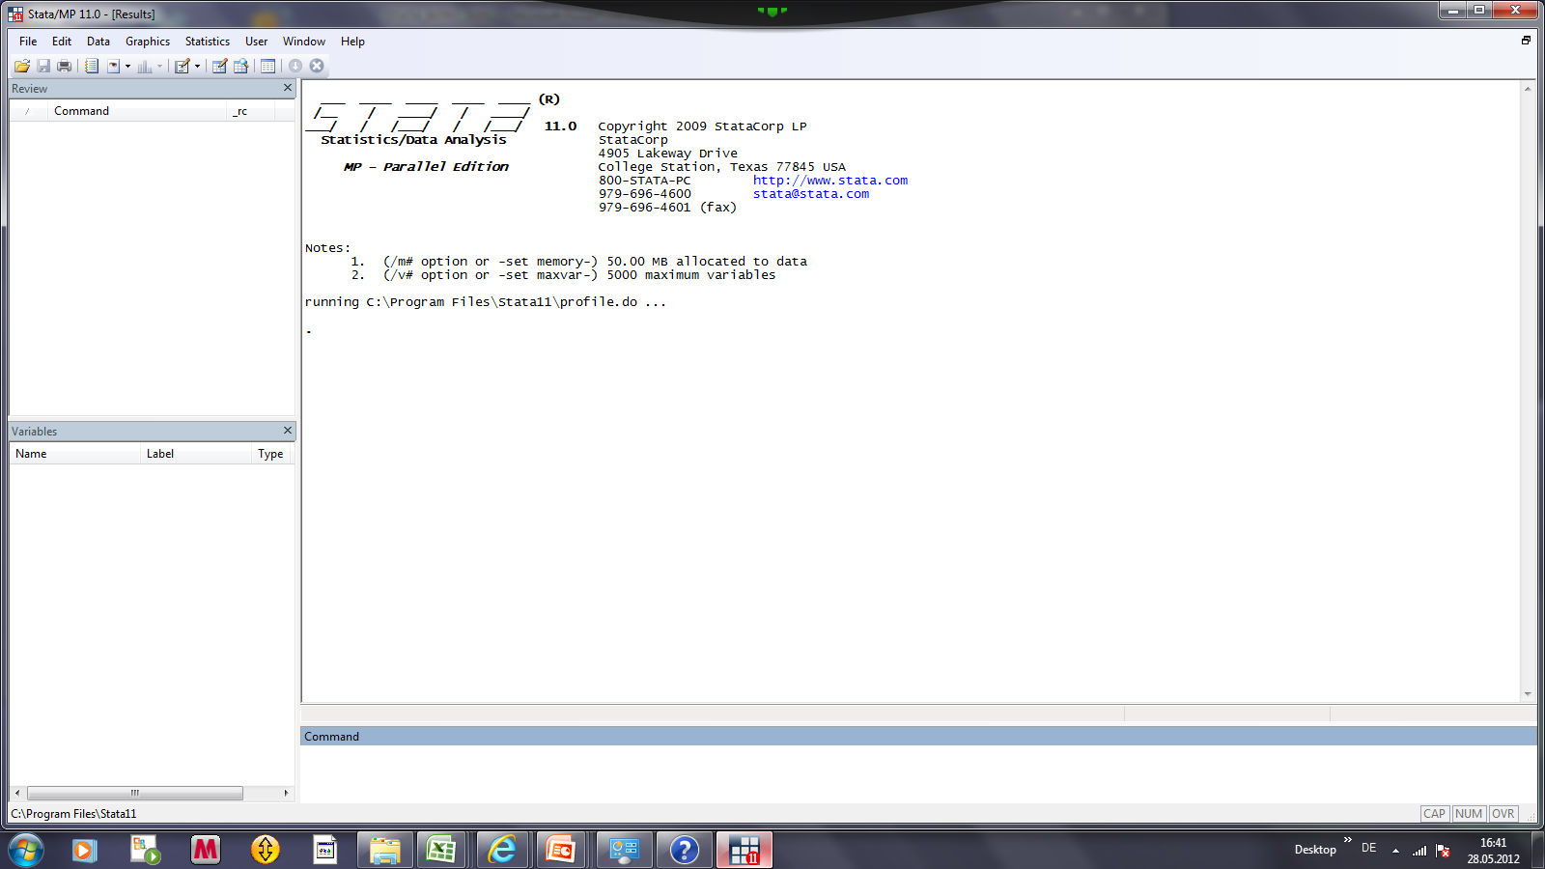
Migration and the Labor Market Session 3: STATA: An Introduction into the Basics
3 Getting started: the STATA empty window

Slide 16
Migration and the Labor Market Session 3: STATA: An Introduction into the Basics
3 Getting started: The STATA empty window
The main window: shows commands, output and messages which arrive during your session

Slide 17
Migration and the Labor Market Session 3: STATA: An Introduction into the Basics
3 Getting started: The STATA empty window
The main window: shows commands, output and messages which arrive during your session
The command window: here you can type your commands

Slide 18
Migration and the Labor Market Session 3: STATA: An Introduction into the Basics
3 Getting started: The STATA empty window
The main window: shows commands, output and messages which arrive during your session
The variables window: Shows variables of your dataset
The command window: here you can type your commands

Slide 19
Migration and the Labor Market Session 3: STATA: An Introduction into the Basics
3 Getting started: The STATA empty window
The review window reports your previous commands
The main window: shows commands, output and messages which arrive during your session
The variables window: Shows variables of your dataset
The command window: here you can type your commands

Slide 20
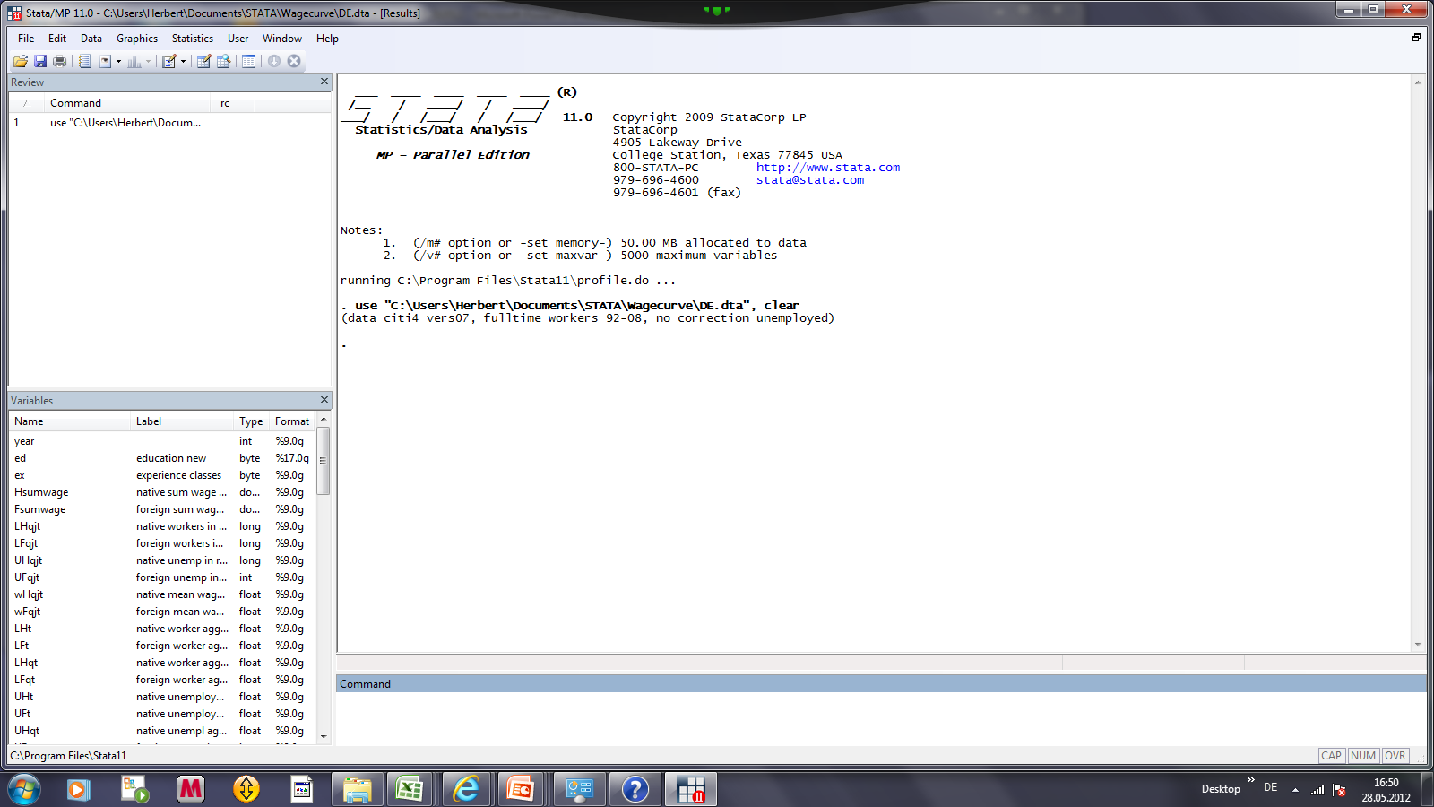
Migration and the Labor Market Session 3: STATA: An Introduction into the Basics
3 Getting started: the windows after data loading
Reports commands (one in this case)
Reports result of commands
List of variables

Slide 21
Migration and the Labor Market Session 3: STATA: An Introduction into the Basics
3 Getting started
In principle, you can start your STATA session by (i) loading your data set and (ii) typing your commands in the command window.
It is however recommended to use the DO FILE EDITOR right from the beginning.
But let’s look at the STATA menues first.

Slide 22
Migration and the Labor Market Session 3: STATA: An Introduction into the Basics
4 The STATA Menues
For watching your data and changing your data by hand you need the DATA BROWSER and the DATA EDITOR.
For starting and running your DO files you need the DO FILE EDITOR.
The other menues are not relevant for the beginning.
The data path
The do file editor
The data editor
The data browser
The variables
manager
The help menue

Slide 23
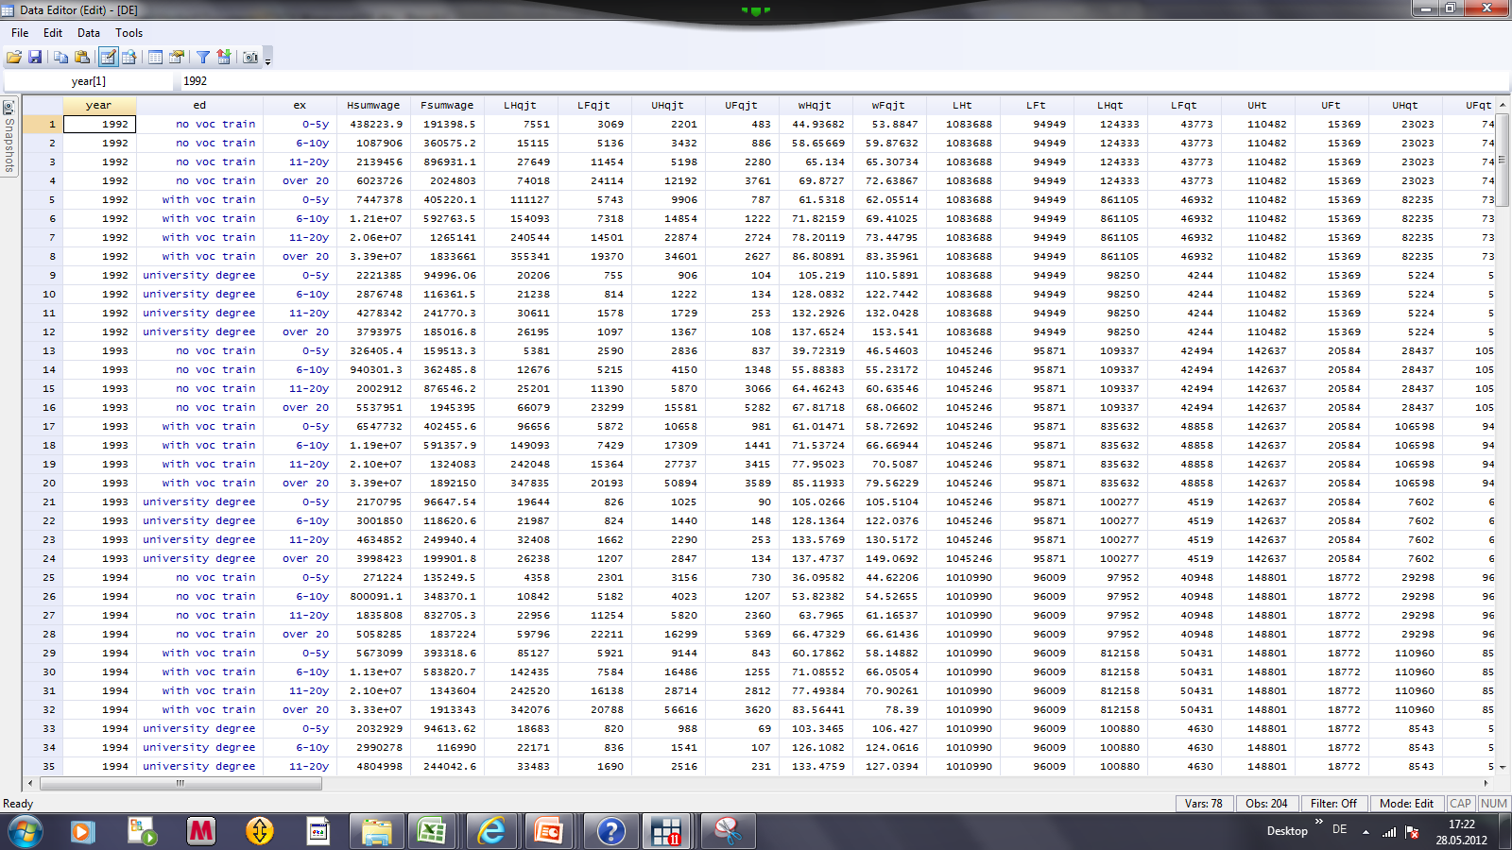
Migration and the Labor Market Session 3: STATA: An Introduction into the Basics
4 The STATA Menues: The DATA EDITOR/BROWSER
The difference between the data browser and the data editor is that you can manipulate data in the editor and only watch them in the browser.

Slide 24
Migration and the Labor Market Session 3: STATA: An Introduction into the Basics
4 The STATA Menues: The DATA EDITOR/BROWSER
Numerical variable labelled
NUMERICAL variable
You have two types of variables: NUMERICAL variables (black or blue) and so-called STRING variables (red) (e.g. text). STATA can identify STRING variables, but you cannot do numerical operations with them.

Slide 25
Migration and the Labor Market Session 3: STATA: An Introduction into the Basics
4 The STATA Menues: The DATA EDITOR/BROWSER
HINT: You can transfer data e.g. from an EXCEL file into a STATA file by copy and paste (STRG C + STRG V) and vice versa in the data editor. But you have to be careful that you EXCEL is run in English, otherwise your data might be read as STRING variables by STATA. Better: Use the import excel command.

Slide 26
Migration and the Labor Market Session 3: STATA: An Introduction into the Basics
5 The Grammar of STATA
General Structure of STATA commands
[prefix :] command [varlist] [if] [in] [weight] [, options]

Slide 27
Migration and the Labor Market Session 3: STATA: An Introduction into the Basics
Grammar of STATA
We will concentrate on:
[prefix :] command [varlist] [if] [in] [weight] [, options]

Slide 28
Migration and the Labor Market Session 3: STATA: An Introduction into the Basics
Commands
[prefix :] command [varlist] [if] [in] [weight] [, options]
What you want to do?
Examples:
regress (make a regression)
summarize (make summary statistics)
graph twoway line (make a graph)

Slide 29
Migration and the Labor Market Session 3: STATA: An Introduction into the Basics
Commands: using abreviations
[prefix :] command [varlist] [if] [in] [weight] [, options]
Examples:
r or reg instead of regress
s or sum instead of summarize
g instead of graph

Slide 30
Migration and the Labor Market Session 3: STATA: An Introduction into the Basics
Grammar of Stata: Variables
[prefix :] command [varlist] [if] [in] [weight] [, options]
varlist is a list of variables, which you have in your dataset
Examples:
wft is the foreign wage
Lft the foreign labor force
You can also use list of variables which comprises a number of variables you have defined before (see working with globals below).

Slide 31
Migration and the Labor Market Session 3: STATA: An Introduction into the Basics
Grammar of STATA: the if-condition
[prefix :] command [varlist] [if] [in] [weight] [, options]
The if condition constrains what you do to a certain condition you have defined.
Example:
You want to replace a variable with certain values if the individuals have higher education:
replace ed3 = 1 if education == 3

Slide 32
Migration and the Labor Market Session 3: STATA: An Introduction into the Basics
Grammar of STATA: the if-condition (cont.)
[prefix :] command [varlist] [if] [in] [weight] [, options]
Another example:
You want to restrict a regression to subsample, e.g. to foreigners only:
reg wqjt mqjt Dqjt Djt Dt if Nft > 0

Slide 33
Migration and the Labor Market Session 3: STATA: An Introduction into the Basics
Grammar of STATA: Options
[prefix :] command [varlist] [if] [in] [weight] [, options]
Options are very often complementing commands, e.g. you can run a regression with fixed effects.
Example:
xtreg wqjt mqjt Dqjt Djt, fe
where fe is the option for fixed effects.

Slide 34
Migration and the Labor Market Session 3: STATA: An Introduction into the Basics
Grammar of STATA: types of variabes
There are two types of variables (data):
numerical variables, e.g.: 0, 1, 501, 0.5, -12 etc.
string variables, e.g.: no voc train , male, female etc.
How to deal with the data types:
Numerical variables: you can do all mathematical operations, e.g. var1 + var2, var1/var2, var1*var2 etc.
String variables: You have to use quotation marks for identification, e.g.
var1 = 1 if sex == “female”

Slide 35
Migration and the Labor Market Session 3: STATA: An Introduction into the Basics
6 Working with DO FILES: General issues
The standard approach is to start your work with a DO FILE
Click on the DO FILE editor button after starting STATA
Load an existing DO FILE or start a new one
Save the DO File at the end of your session

Slide 36
Migration and the Labor Market Session 3: STATA: An Introduction into the Basics
Open your DO FILE editor
After starting STATA click on the DO FILE editor button
The Do-file editor

Slide 37
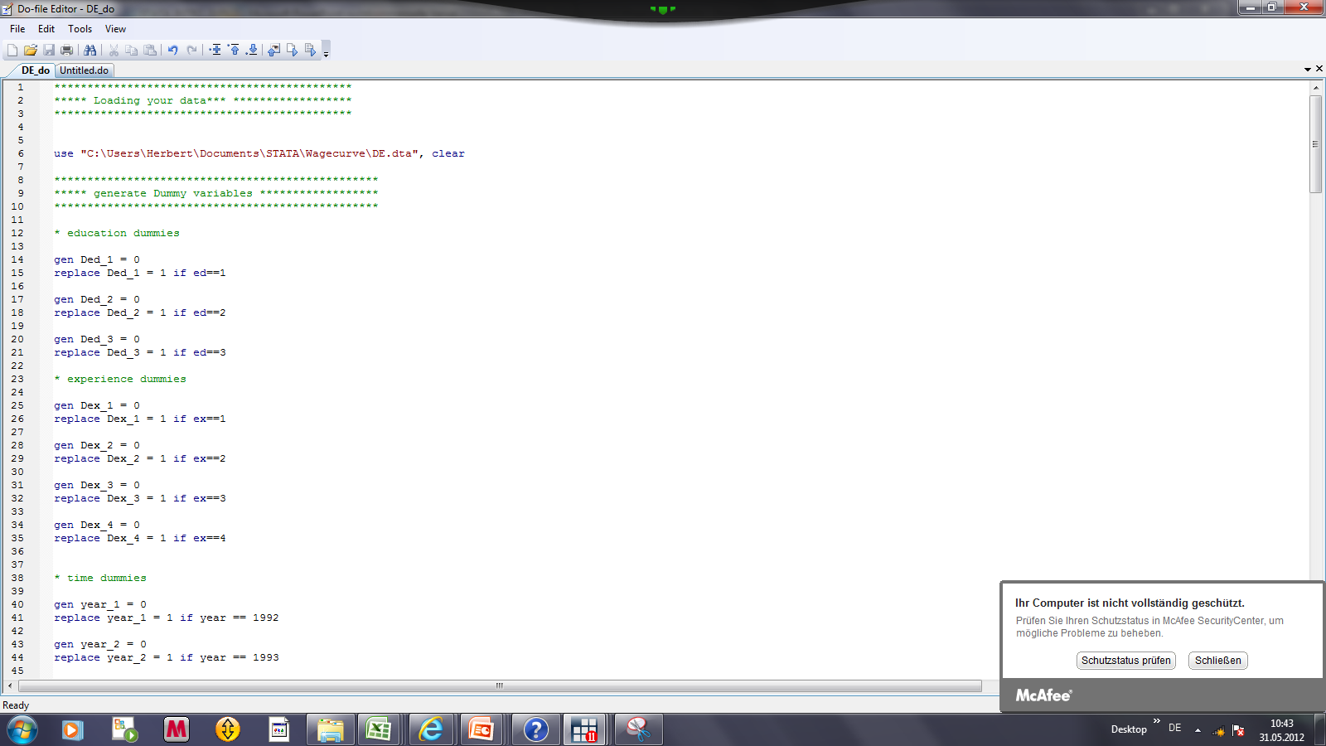
Migration and the Labor Market Session 3: STATA: An Introduction into the Basics
How does a DO FILE look like
Descriptions of what you have done in stars *
Commands

Slide 38
Migration and the Labor Market Session 3: STATA: An Introduction into the Basics
The DO FILE menue
Clicking this button runs the entire DO FILE (not recommended)
Clicking this button runs a selection of marked commands (recommended)
Note: STATA stops the DO File execution after the first mistake in your commands. That makes it advisable to proceed step by step.

Slide 39
Migration and the Labor Market Session 3: STATA: An Introduction into the Basics
7 Organizing your session: General issues
The basis for all what you do is your Do-File which you open in all sessions first
Work with a small data set and do the generation of all additional variables based on your Do-File in the beginning of each session. Save only the small dataset. That is efficient from the data management side and reduces the risk that you delete/change important variables which you cannot restore. Change somewhere a save version of your dataset
Use a LOG File that you can see in case of a problem what you have actually done. You seldomly look at it, but you might miss it in an important case
At end of session save the Do-file and close Log file
Close data-file but do not save it: this can destroy your dataset!

Slide 40
Migration and the Labor Market Session 3: STATA: An Introduction into the Basics
Starting your session: Step 1
Begin your Do-file with the following useful commands:
set more off
Is not necessary but useful
Helps data processing e.g. in long regressions, long statistics
capture log close
closes log file if one is open
the capture (cap) command is useful since STATA executes this command only if it is need, e.g. if a log file is open
log using “path\DE”, replace
Opens a Log-File with the name “DE”

Slide 41
Migration and the Labor Market Session 3: STATA: An Introduction into the Basics
Step 2: Loading your data
If you have already a STATA data file:
The use command loads the data
the “path\data\DE.dta, clear” provides STATA the information on the path where to find the data and the name of the data file (e.g. DE.dta)
the clear command after the comma clears the memory, which is needed if you have used other data sets before
Path is the path where STATA can find your data, e.g. C:\\Users\Herbert\Documents\STATA\ Projectseminar_2016

Slide 42
Migration and the Labor Market Session 3: STATA: An Introduction into the Basics
Loading your data (I/II)
Write the command use „path\XXX.dta“, clear
Mark the line and run the command by clicking the execution button

Slide 43
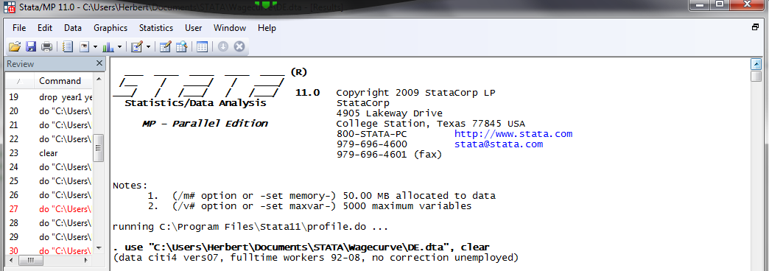
Migration and the Labor Market Session 3: STATA: An Introduction into the Basics
Loading your data (II/II)

Slide 44
Migration and the Labor Market Session 3: STATA: An Introduction into the Basics
Loading your data from EXCEL
If you have to import data e.g. from an Excel file:
Use the import excel using path\data\de.xlsx, firstrow command
the import excel tells STATA that it has to import a file with a different data format, in this case excel
using path\data\de.xlsx tells data where to find the data and the file name
The option after the comma , firstrow tells STATA that it has to treat the first row of the Excel sheet as the names (labels) of the variables. Otherwise it thinks it are data and you end up in a mess.

Slide 45
Migration and the Labor Market Session 3: STATA: An Introduction into the Basics
Ending your session
Save your Do-file, e.g.
save uk.do
Close your Log-file:
log close
Attention: in normal cases don’t save your Data-file. If you do this, all changes in your data set are saved and the original data set might be destroyed. You cannot restore the old dataset once it is saved.
Of course, if you want to save some changes of your dataset, you can save it.

Slide 46
Migration and the Labor Market Session 3: STATA: An Introduction into the Basics
8 Processing your data
Your can generate new variables and replace existing ones
E.g. generate a numerical variable by using the information from a STRING variable
gen ed = . generates the variable ed with missing values in the first place
In the next step you can replace the values of this variables by using
replace ed = 1 if education ==“no voc training”
Which assigns the varianble a value of 1 if the person/group has no vocational training

Slide 47
Migration and the Labor Market Session 3: STATA: An Introduction into the Basics
Generating new variables
replace ed = 1 if education == “no voc training”
replace tells STATA to replace the values of the variable, in this case of the ed variable by 1
the if option tells STATA under which conditions, note that you have to use double equality sign (==) after the if option
The “…” in “no vocational training” tells STATA that we have a STRING variable
Then repeat this until all values of your variable are filled

Slide 48
Migration and the Labor Market Session 3: STATA: An Introduction into the Basics
Transform your data by using operators:
Useful operators in STATA:
+ add
- subtract
* multiply
/ divide
ln transform into natural log
exp transform into exponential value

Slide 49
Migration and the Labor Market Session 3: STATA: An Introduction into the Basics
GENERATE Dummy Variables
Example:
Reconsider Borjas (2003) model
Why dummy variables?
How to create dummy variables
Advanced techniques to create dummy variables

Slide 50
Migration and the Labor Market Session 3: STATA: An Introduction into the Basics
Recall the Borjas (2003)-Modell
where
y_{ijt} is the dependent variable (e.g. log wage, unemployment rate)
s_{i} is an education dummy
x_{j} is an education dummy
pi_{j} is a time dummy
plus many interaction dummies
Thus, we have to create quite a bunch of dummmy variables.
But, in the first place, what are dummy variables doing?

Slide 51
Migration and the Labor Market Session 3: STATA: An Introduction into the Basics
The Role of Dummy Variables
Y
x

Slide 52
Migration and the Labor Market Session 3: STATA: An Introduction into the Basics
Generate dummy variables: how to do
Generating DUMMY variables
Use the gen command, e.g.
gen Ded1 = 0
This creates a variable consisting only of zeros
Then use the replace command, e.g.
replace Ded1 = 1 if ed == 1
This replaces the zeros with 1 if the variables ed1 has a values of 1.

Slide 53
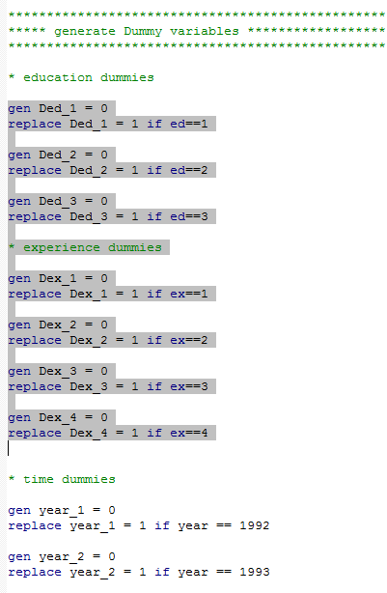
Migration and the Labor Market Session 3: STATA: An Introduction into the Basics
Generating Dummy Variables: DO FILE commands

Slide 54
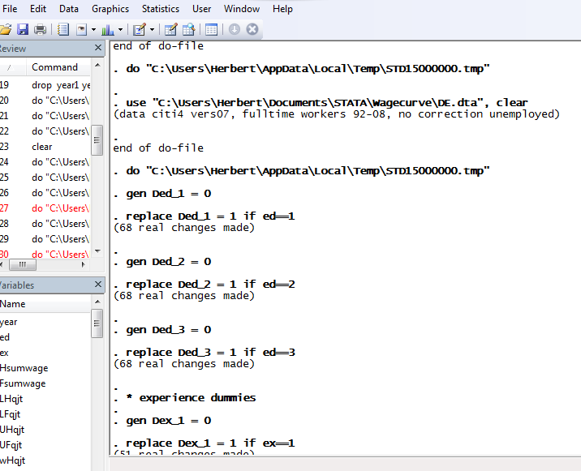
Migration and the Labor Market Session 3: STATA: An Introduction into the Basics
Generating Dummy Variables: STATA main window

Slide 55
Migration and the Labor Market Session 3: STATA: An Introduction into the Basics
Dummy variables (cont.)
Another example for generating dummy variables:
Use the gen command, e.g.
gen Dt1 = 0
This creates a variable consisting only of zeros
Then use the replace command, e.g.
Dt1 = 1 if year == 1991
This replaces the zeros with 1 if the year variable has a values of 1991
Note: The STATA syntax requires that you have to use after an if command always a double == for the definition of the value

Slide 56
Migration and the Labor Market Session 3: STATA: An Introduction into the Basics
Generating dummy variables: advanced techniques
Creating series of dummy variables if it is too cumbersome to create them individually, e.g. in case of interaction dummies. Use “forvalues” command
Syntax:
forvalues i = 1/3 { forvalues j = 1/4{ gen D_ed`i’*D_ex`j’ } }
i.e. for each value i = 1,2,3 and each value j = 1,2,3,4 you generate an interaction dummy by multiplying the dummy variables for education and experience. Take care of the {}!

Slide 57
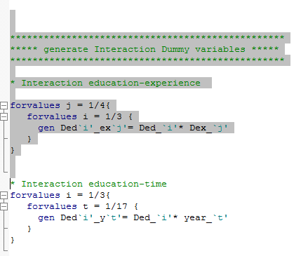
Migration and the Labor Market Session 3: STATA: An Introduction into the Basics
Generating Dummy Variables: Advanced techniques

Slide 58
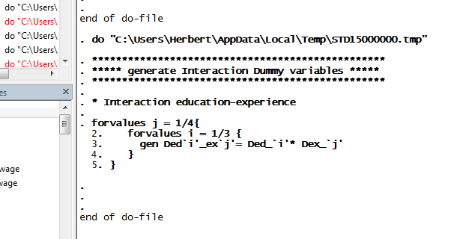
Migration and the Labor Market Session 3: STATA: An Introduction into the Basics
Generating Dummy Variables: Advanced techniques

Slide 59
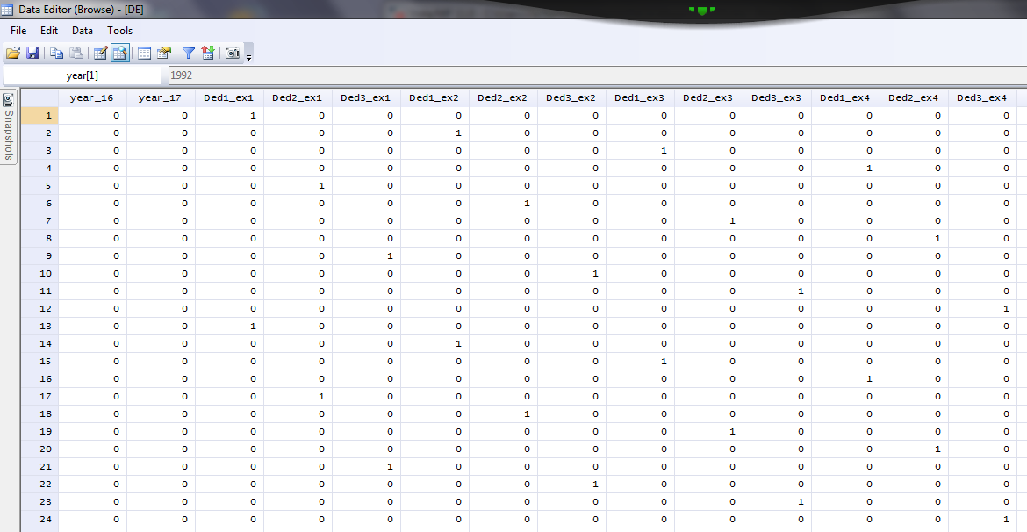
Migration and the Labor Market Session 3: STATA: An Introduction into the Basics
Generating Dummy Variables: Advanced techniques

Slide 60
Migration and the Labor Market Session 3: STATA: An Introduction into the Basics
Log transformation
Econometrics is linear, while the real world is non-linear, e.g. concave, convex
Replacing linear variable into log variable allows estimating non-linear realtionships between two variables
Transforming variables into log variables
Syntax:
gen ln_wijt = ln wijt
By using again the gen command you can transform the wage variable wijt into the natural logarithm of the wage by applying the ln operator

Slide 61
Migration and the Labor Market Session 3: STATA: An Introduction into the Basics
Log transformation
Econometrics is linear, while the real world is non-linear, e.g. concave, convex
Replacing linear variable into log variable allows estimating non-linear relationships between two variables
If the dependent and the independent variable are transformed into natural logs we have moreover a nice interpretation of the coefficient: it is an elasticity, i.e. tells you by how many per cent the dependent variable changes if the independent variable changes by 1 per cent

Slide 62
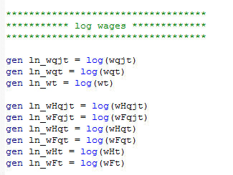
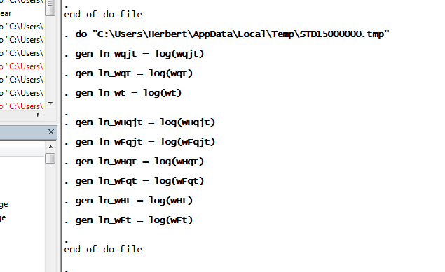
Migration and the Labor Market Session 3: STATA: An Introduction into the Basics
Transforming data

Slide 63
Migration and the Labor Market Session 3: STATA: An Introduction into the Basics
Organize your data with globals
It is not convenient if you have to work with too many variables, e.g. 200 dummy variables (that is cumbersome to type some by hand)
You can define globals, which comprise many variables
Syntax:
glo [name of global [list of variables]
glo Di Ded_1 Ded_2 D_ed3
i.e the global Di consists of the variables Ded_1 Ded_2 and Ded_3
If you want to use the global later you have to type
$[globalname], i.e. $Di

Slide 64
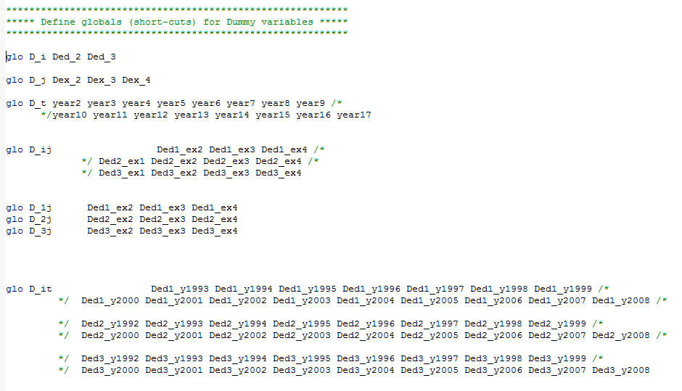
Migration and the Labor Market Session 3: STATA: An Introduction into the Basics
Creating globals

Slide 65
Migration and the Labor Market Session 3: STATA: An Introduction into the Basics
9 Descriptive statistics
Any econometric analysis requires in the first step that you provide descriptive statistics to the reader. This helps to understand what’s going on
This can be easily done with the sum command
sum [variable name(s)]
sum LHijt LFijt wijt ln_wijt
The sum command creates a table with the complete descriptive statistics, i.e. observations, mean, standard deviation, minimum, maximum

Slide 66
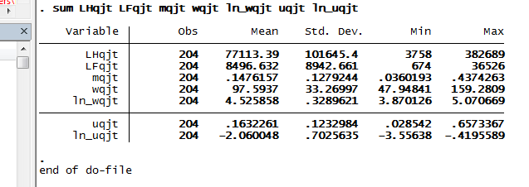
Migration and the Labor Market Session 3: STATA: An Introduction into the Basics
Summary statistics
Summary statistics/ descriptive statistics

Slide 67
Migration and the Labor Market Session 3: STATA: An Introduction into the Basics
10 Making graphs
Present your data graphically
It is usually helpful if you present the main information /vairables in your data set graphically
There are many graphical commands, use the Graphics menue or the respective commands

Slide 68
Migration and the Labor Market Session 3: STATA: An Introduction into the Basics
Making graphs (cont.)
The simplest way is to show the development of your variable(s) over time
Syntax:
graph twoway line [variable1] [variable2] if …
graph twoway line wqjt year if ed==1 & ex == 1
This produces a two-dimensional graph with the wage on the vertical and the year on the horizontal axis for education group 1 and experience group 1

Slide 69
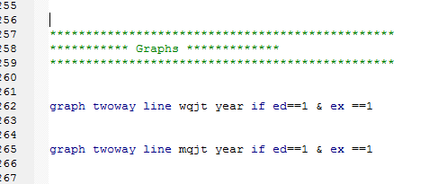
Migration and the Labor Market Session 3: STATA: An Introduction into the Basics
Making a graph

Slide 70
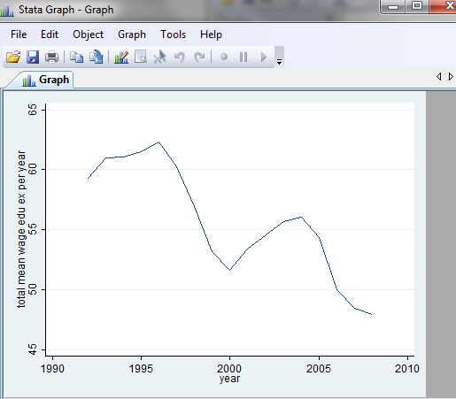
Migration and the Labor Market Session 3: STATA: An Introduction into the Basics
Graph of mean wage in education 1 and experience 1
Example: line graph

Slide 71
Migration and the Labor Market Session 3: STATA: An Introduction into the Basics
Graphs with two Y-axes
Making graphs with two variables on the y axis displayed on two y axes
Syntax:
graph twoway line ([variable1] [variable2]) ([variable 3][variable2], yaxis(2)) if …
graph twoway line (wqjt year) (mqjt year) if ed==1 & ex == 1
This produces a two-dimensional graph with the wage and the migration rate on the vertical axes with different scales and the year on the horizontal axis for education group 1 and experience group 1

Slide 72
Migration and the Labor Market Session 3: STATA: An Introduction into the Basics
Scatter plots
Making graphs with scatter plots which show by point clouds the relationship between two variables
Syntax:
graph twoway scatter [variable1] [variable2] if …
graph twoway scatter wqjt mqjt) if ed==1 & ex == 1
This produces a two-dimensional scatter plot with a cloud of points which show for each observation in the sample of education group 1 and experience group 1 the values of the wage and the migration rate

Slide 73
Migration and the Labor Market Session 3: STATA: An Introduction into the Basics
Scatter plots with a regression line
Making graphs with scatter plots which show by point clouds and a simple regression line the correlation (no causality) between two variables
Syntax:
graph twoway scatter [variable1] [variable2] || lfit [variable1] [variable2] if …
graph twoway scatter wqjt mqjt || lftit wqjt mqjt if ed==1 & ex == 1
This produces a two-dimensional scatter plot plus a regression line with a cloud of points which show for each observation in the sample of education group 1 and experience group 1 the correlation between the wage and the migration rate

