Slide 1
Central Student Advisory Service –
Support and Advisory Services for Students
Central Student Advisory Services – Alexander Ostermann, M.A.
Notes:
Hinweis:
Anpassen der Fußzeile: Die PowerPoint-Vorlagen weisen alle eine Fußzeile auf, die sich natürlich individuell anpassen lässt. Um z.B. den Titel des Vortrages und den Namen des Referenten einzutragen muss dazu der Hauptfolienmaster geändert werden. In PowerPoint 2007/2010 muss man dazu unter dem Menü-Punkt "Ansicht" den Button "Folienmaster" anklicken. Am linken Bildschirmrand wird dann die Liste der Masterfolien angezeigt. Der oberste ist der Hauptmaster in dem sich die Textfelder der Fußzeile problemlos ändern lassen.

Slide 2
Central Student Advisory Services
You can consult the staff of the Central Student Advisory Services as your first point of contact for all study-related questions and problems
With your consent, we will refer you to the appropriate service offices and contact persons as needed
The advice is neutral, confidential an free of charge

Slide 3
Other Advisory Service for Students
Subject-Specific Academic Advisory is responsible:
a) for answering questions concerning degree program
b) selection and issues arising during your curriculum
Lectures are the contact persons for questions relating to courses an exams within.
Examination Board is your first resource for:
a) examination and study regulations,
b) recognition of study and examination credits,
c) prolongation of the study duration.

Slide 4
Other Advisory Service for Students
International Office is the central contact point for all international students in Bamberg, and for all students from Bamberg who aspire to study abroad
The Language Centre offers courses in a range of languages, which are generally free of charge for students of the University. Courses may be part of existing degree programs, or may be open to students from any program
IT-Service is your service partner in all matters of information technology dealing with studies, teaching, research and organization

Slide 5
Other Advisory Service for Students
Family Office is the central contact point and resource centre for students and staff with family responsibilities
Anti-Discrimination Office provides advice and support for all university members as regards discrimination, exclusion and harassment based on protected characteristics
Academic Equal Opportunity Officer is essentially responsible for general advice on women-specific matters and the advancement of women
Office for Students with Disabilities provides advice and support for all health problems that restrict the course of studies

Slide 6
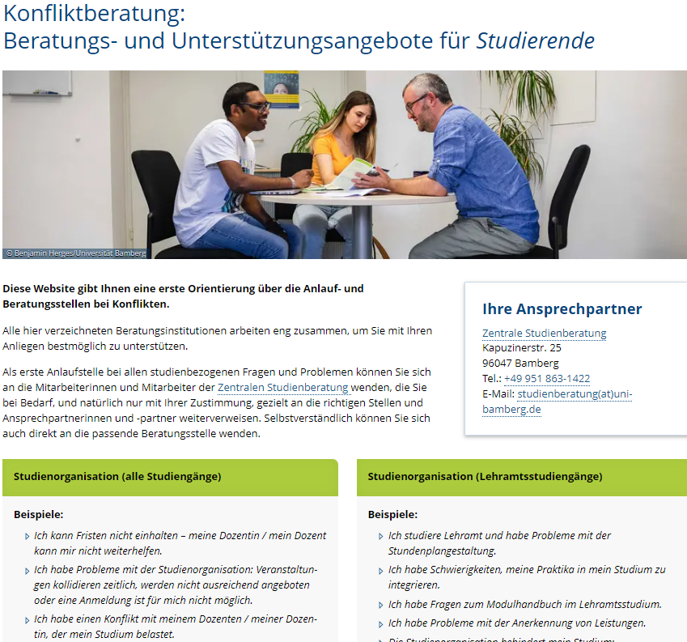
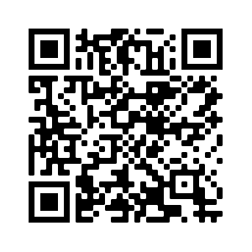
Conflict Counselling:
Support and Advisory Services for Students
This website provides you with an initial overview of the people and advisory services
https://www.uni-bamberg.de/studium/im-studium/beratung-fuer-studierende/

Slide 7
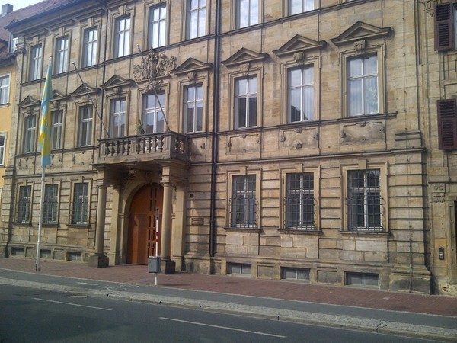
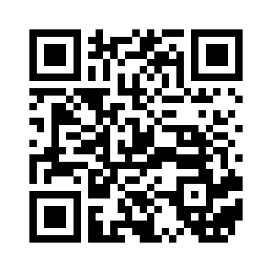
Central Student Advisory Service
Kapuzinerstraße 25
96047 Bamberg
Tel: 0951/863-1422
studienberatung@uni-bamberg.de

Slide 8

The Central Student Advisory Service
wishes you a smooth and successful start to your academic journey at the University of Bamberg.

