Slide 1
WIAI EXAMINATION BOARDS
01110111 01101001 01100001 01101001 00100000 01100010 01100001 01101101 01100010 01100101 01110010 01100111 00100000 01110010 01101111 01100011 01101011 01110011 00100000 01101001 01101110 01110100 01100101 01110010 01100100 01101001 01110011 01111010 01101001 01110000 01101100 01101001 01101110 11000011 10100100 01110010 00100000 01101001 01101110 01110100 01100101 01110010 01101110 01100001 01110100 01101001 01101111 01101110 01100001 01101100 00100000 01110000 01100101 01110010 01110011 11000011 10110110 01101110 01101100 01101001 01100011 01101000 01110111 01101001 01100001 01101001 00100000 01100010 01100001 01101101 01100010 01100101 01110010 01100111 00100000 01110010 01101111 01100011 01101011 01110011 00100000 01101001 01101110 01110100 01100101 01110010 01100100 01101001 01110011 01111010 01101001 01110000 01101100 01101001 01101110 11000011 10100100 01110010 00100000 01101001 01101110 01110100 01100101 01110010 01101110 01100001 01110100 01101001 01101111 01101110 01100001 01101100 00100000 01110000 01100101 01110010 01110011 11000011 10110110 01101110 01101100 01101001 01100011 01101000 01110111 01101001 01100001 01101001 00100000 01100010 01100001 01101101 01100010 01100101 01110010 01100111 00100000 01110010 01101111 01100011 01101011 01110011 00100000 01101001 01101110 01110100 01100101 01110010 01100100 01101001 01110011 01111010 01101001 01110000 01101100 01101001 01101110 11000011 10100100 01110010 00100000 01101001 01101110 01110100 01100101 01110010 01101110 01100001 01110100 01101001 01101111 01101110 01100001 01101100 00100000 01110000 01100101 01110010 01110011 11000011 10110110 01101110 01101100 01101001 01100011 01101000 01110111 01101001 01100001 01101001 00100000 01100010 01100001 01101101 01100010 01100101 01110010 01100111 00100000 01110010 01101111 01100011 01101011 01110011 00100000 01101001 01101110 01110100 01100101 01110010 01100100 01101001 01110011 01111010 01101001 01110000 01101100 01101001 01101110 11000011 10100100 01110010 00100000 01101001 01101110 01110100 01100101 01110010 01101110 01100001 01110100 01101001 01101111 01101110 01100001 01101100 00100000 01110000 01100101 01110010 01110011 11000011 10110110 01101110 01101100 01101001 01100011 01101000 01110111 01101001 01100001 01101001 00100000 01100010 01100001 01101101 01100010 01100101 01110010 01100111 00100000 01110010 01101111 01100011 01101011 01110011 00100000 01101001 01101110 01110100 01100101 01110010 01100100 01101001 01110011 01111010 01101001 01110000 01101100 01101001 01101110 11000011 10100100 01110010 00100000 01101001 01101110 01110100 01100101 01110010 01101110 01100001 01110100 01101001 01101111 01101110 01100001 01101100 00100000 01110000 01100101 01110010 01110011 11000011 10110110 01101110 01101100 01101001 01100011 01101000 01110111 01101001 01100001 01101001 00100000 01100010 01100001 01101101 01100010 01100101 01110010 01100111 00100000 01110010 01101111 01100011 01101011 01110011 00100000 01101001 01101110 01110100 01100101 01110010 01100100 01101001 01110011 01111010 01101001 01110000 01101100 01101001 01101110 11000011 10100100 01110010 00100000 01101001 01101110 01110100 01100101 01110010 01101110 01100001 01110100 01101001 01101111 01101110 01100001 01101100 00100000 01110000 01100101 01110010 01110011 11000011 10110110 01101110 01101100 01101001 01100011 01101000 01110111 01101001 01100001 01101001 00100000 01101100 01101001 01100011 01101000 01110111 01101001 01100001 01101001 00100000 01100010 01100001 01101101 01100010

Slide 2
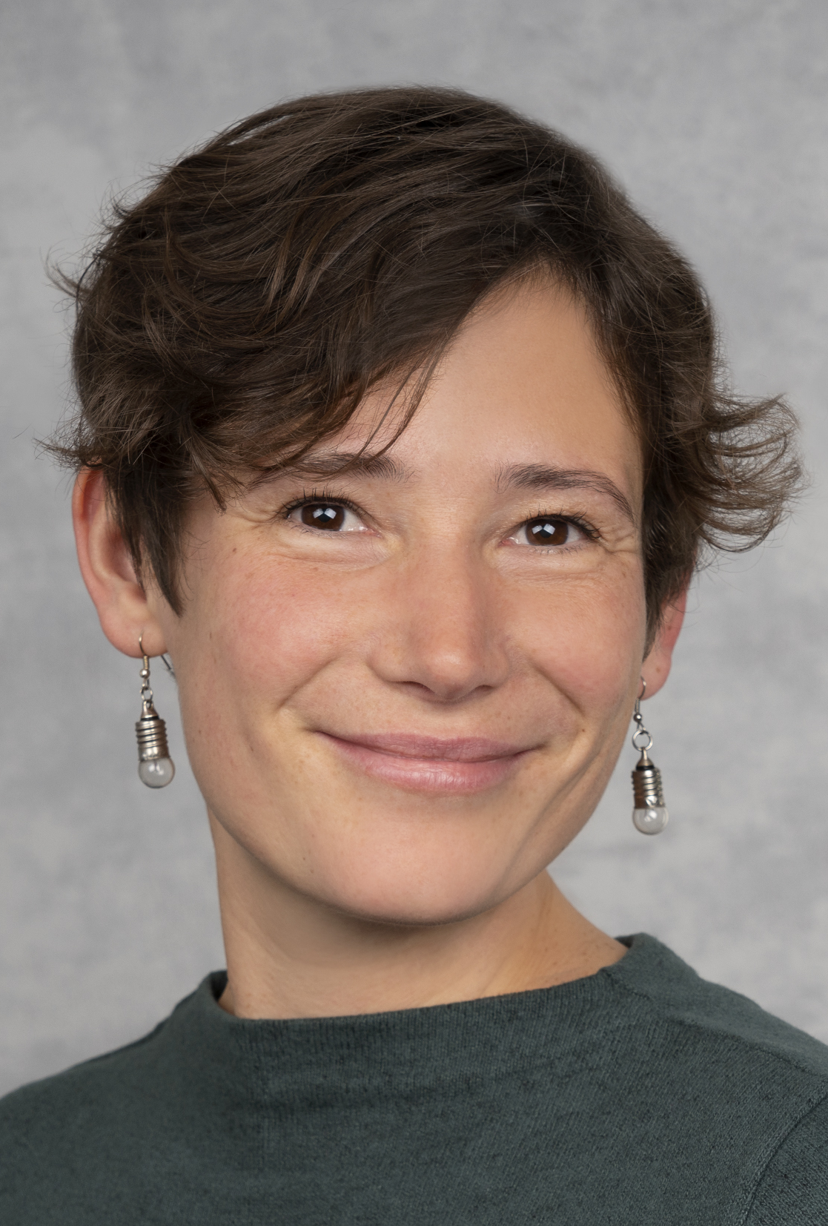

WIAI EXAMINATION BOARDS
Examination Board Inf./ AI
Chairperson: Prof. Dr. Stefan Ultes
Assistant: Ines Häuser | pa.inf-ai@uni-bamberg.de
Degree programmes:
BA / MA Applied Computer Science
BA / MA Computer Science / International Software System Science
BA Artificial Intelligence & Data Science
MA Computing in the Humanities
MA Interaction Research & Design
Examination Board WI/ IISM/ WipaedWI
Chairperson: Prof. Dr. Thomas Kude
Assistant: Tim Kipphan | servicedesk.wi@uni-bamberg.de
Degree programmes:
BA / MA Information Systems
BA / MA International Information Systems Management

Slide 3
Contact us for…
…crediting of modules
…questions on exams, regulations (StuFPOs), and module handbook
…studying abroad | coordinating Learning Agreements
…BAföG (→ for all students: Tim Kipphan)

Slide 4
Takeaways
visit our FAQ websites for general questions first (AI / WI)
know your StuFPOs, for instance, study progress review (“Studienfortschrittskontrolle”) relevant in all bachelor degree programs
subscribe to the relevant Virtual Campus courses (AI / WI)
keep deadlines, specifically for exam registration!
Talk to us before it's too late! We try, but we cannot work miracles (for instance, when reaching the maximum study duration)

