Slide 1



Kontaktstelle Studium und Behinderung
Studying at the University of Bamberg with a disability and/or chronic illness
Notes:
Hinweis:
Anpassen der Fußzeile: Die PowerPoint-Vorlagen weisen alle eine Fußzeile auf, die sich natürlich individuell anpassen lässt. Um z.B. den Titel des Vortrages und den Namen des Referenten einzutragen muss dazu der Hauptfolienmaster geändert werden. In PowerPoint 2007/2010 muss man dazu unter dem Menü-Punkt "Ansicht" den Button "Folienmaster" anklicken. Am linken Bildschirmrand wird dann die Liste der Masterfolien angezeigt. Der oberste ist der Hauptmaster in dem sich die Textfelder der Fußzeile problemlos ändern lassen.

Slide 2

Target group
Students with disabilities (e.g. limited mobility, hearing and visual impairments) and chronic illnesses (e.g. diabetes, epilepsy, asthma, rheumatism)
Acutely ill students (e.g. arm fracture after accident)
Mentally ill students (e.g. anxiety disorders or depression)
Students with ADHS, dyslexia and dyscalculia
If you have been ill for longer than six months, you can receive compensation for disadvantages during examinations

Slide 3

Examples of measures to compensate for disadvantages
Extension of the exam time
Possibility to interrupt exams with breaks that are not counted towards the completion time
Possibility of co-determination with regard to date, location, supervisor (e.g. specific gender)
Examinations can be held in a separate room
Extension of deadlines for the course of study
Authorisation of aids, e.g. assistive technologies

Slide 4

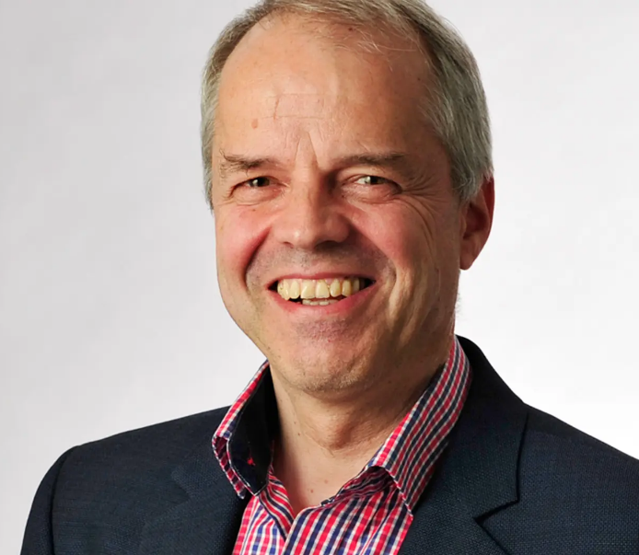
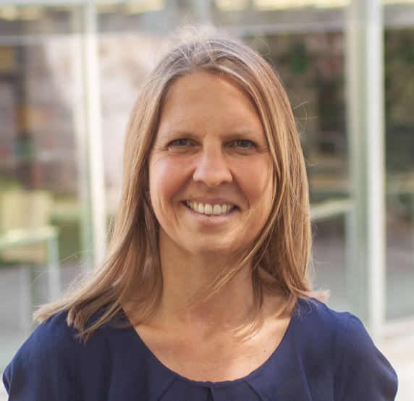
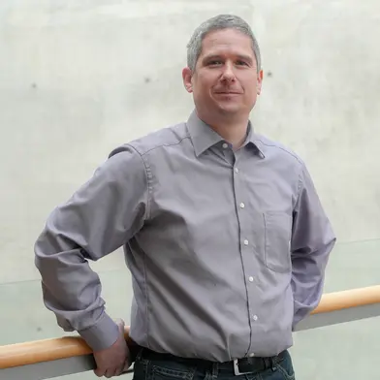
Counsellors, consultation hours & contact
Prof. Jörg Wolstein
Consultation hours by appointment
Sabina Haselbek
Kai Imhof
Consultation hours: Monday 14.00 - 16.00 Uhr Thursday 9.30 - 12.00 Uhr
Consultation hours : Tuesday 13.15 - 14.45 Uhr Friday 9.00 - 11.00 Uhr
Information & contact: https://www.uni-bamberg.de/bafbs/

