Slide 1

Erstsemestereinführungstage |
First Semester Introductory Days
Summer Semester 2026
7th to 11th April
Information Systems and Applied Computer Sciences Faculty
Notes:
Begrüßung
Vorstellung
Rückblick
Einleitung Dozenten

Slide 2
Welcome Addresses and General Information
Schedule for the Plenary Session
10:30 a.m. – 12:00 p.m.
Prof. Dr. Dominik Herrmann, Dean of the Faculty
Ines Häuser, WIAI Examination Boards
Career and International Center
Dr. Sarah Böhlau, Contact point for studies and disabilities
Anna Keiderling, Academic Equal Opportunity Office of the Faculty WIAI
Dr. Katharina Kanitz, Central Student Counseling at Bamberg University
Elias Leikeb, student senator
Henri Ganz and Paul Widzgowski, student council (“Fachschaft WIAI“)
07.04.2026
Notes:
Prof. Guido Wirtz, Dekan der Fakultät
übernimmt auch die Präsentation von Prof. Beimborn, dem Studiendekan der WIAI
Tim Kipphan für den Career und den International Center
Ines Häuser für die Prüfungsausschüsse der Fakultät
Franziska vertritt die Fakultätsfrauenbeauftragte Frau Prof. Schmid
Kai Imhof von der zentralen Studienberatung
Zuletzt melden sich Theresa und ich nochmal bei euch und erzählen euch etwas über die Fachschaft

Slide 3


Fachschaft WIAI – The Student Council
Who are we?
students, just like you!
7 elected representatives and a magnificent community of devoted procrastinators
not to forget: Fooboar, our mascot
14.04.2025

Slide 4



Fachschaft WIAI – The Student Council
What do we do?
We welcome new students (aka you) to the faculty.
We provide Mate (and helpful advice) to take on any problems regarding your studies.
We represent your interests in a range of university committees.
We organize a collection of events (Summer Barbecue, Christmas Party, regulars‘ table).
We offer independent workshops (LaTeX, Linux, …).
We provide (more or less) useful services for your studies (suche.wiai.de, …).
Our goal is to make your time in Bamberg as enjoyable as possible.
14.04.2025

Slide 5
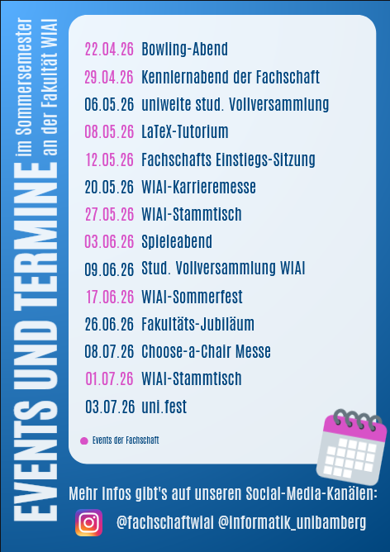

More events this summer
from Fachschaft WIAI, faculty WIAI and many more
even more events
LaTeX-Workshop
Bowling Night
Regulars‘ Table by Fachschaft WIAI
„Choose-a-chair“ Fair
WIAI summer party
Games Night
and many more!
14.04.2025
Notes:
Kommende Veranstaltungen

Slide 6


Fachschaft WIAI – The Student Council
Where can you find us?
WE5/02.104 (on the second floor, next to the small staircase)
fachschaft-wiai.stuve@uni-bamberg.de
+49 951 863-1219
www.uni-bamberg.de/wiai/fs
@fachschaftwiai
@fachschaftwiai
Join us at our introductory meeting on April 29th, 6:15 p.m. (WE5/01.006)! We are always looking for fellow procrastinators.
14.04.2025

Slide 7
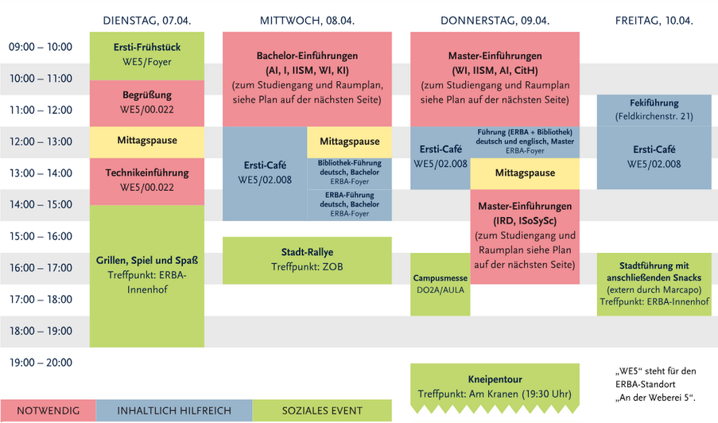


Upcoming events in the next days
from Fachschaft WIAI and other student groups
14.04.2025
Notes:
Kommende Veranstaltungen

Slide 8
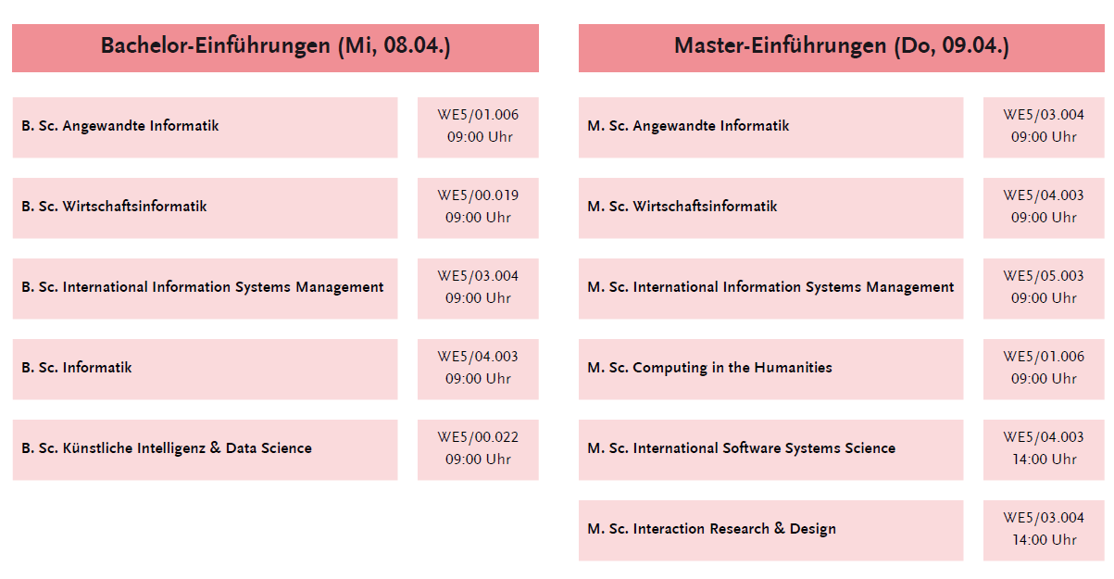
Upcoming events in the next days
from Fachschaft WIAI and other student groups
14.04.2025
Notes:
Kommende Veranstaltungen

Slide 9
Upcoming events in the near future
from Fachschaft WIAI and other student groups
Upcoming events:
Party after „Kneipentour“, 16.04. @ Live-Club
Bowling Night, 22.04. @ Bowlinghaus Bamberg
Student Council Introductory Meeting, 29.04., 6:15 p.m. @ WE5/01.006
WIAI Career Day, 24.05.
‒
07.04.2025
Notes:
Kommende Veranstaltungen

Slide 10

Fachschaft WIAI – The Student Council
Thanks to our tutors and helpers!
Clara Laura Jessi Sandra Tobias Theresa Laetitia Jochen Florian Janne Josi Alice Marvin Frederick Lex Celina Marie Jonas David Katharina Kevin Vanessa
Source: https://xkcd.com/1543/
14.04.2025

