Slide 1

WIAI Career Service & International Center

Slide 2
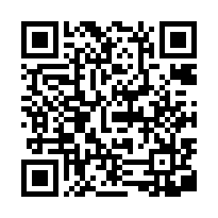
WIAI Career Service
WIAI is the only faculty at the University of Bamberg that offers a career service to its students.
Some of our services*:
*Please note that not all services are offered during semester breaks.
Job portal (Jobbörse WIAI @VC)
SIGN IN
Yearly Career Day (Karrieretag WIAI)
Corporate Internship Program
CV Check

Slide 3

Career Day WIAI (May 20, 2026)
Each summer semester, our faculty hosts its own career day:
Job fair with 20+ regional and international companies
CV Checks
Application training
Presentations
© Tim Kipphan/Uni Bamberg

Slide 4

WIAI International Center
📧 studium-international.wiai@uni-bamberg.de
Prof. Michael Mendler (PhD)
International Affairs Officer

Slide 5
Your Contact Points
International Office
Exchange programs with > 300 universities in Europe and Overseas
Consulting and information events
Application office for exchange programmes
Application Deadline for 27/28: end of November 2026
https://www.uni-bamberg.de/international-office/
International Representative WIAI (Prof. Michael Mendler)
VC Course „Studium International“ (password: „International“)
Career Service & International Center
VC Course “Jobbörse WIAI”
Advice on the corporate internship program
Fachschaft WIAI: Information event “WIAI im Ausland”

Slide 6


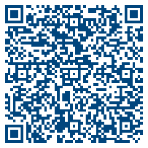
Language Courses at the Language Center
Some
deadlines
end soon!
Do not miss: Registration deadlines for foreign language courses
English for IT (highly recommended!)

Slide 7


Have a good and successful start to the new semester!
Kontakt: N.N. (Position currently unfilled)
E-Mail: careerservice.wiai@uni-bamberg.de
Website: https://www.uni-bamberg.de/wiai/career/

