Slide 1
WIAI INTERNATIONAL CENTER
01110111 01101001 01100001 01101001 00100000 01100010 01100001 01101101 01100010 01100101 01110010 01100111 00100000 01110010 01101111 01100011 01101011 01110011 00100000 01101001 01101110 01110100 01100101 01110010 01100100 01101001 01110011 01111010 01101001 01110000 01101100 01101001 01101110 11000011 10100100 01110010 00100000 01101001 01101110 01110100 01100101 01110010 01101110 01100001 01110100 01101001 01101111 01101110 01100001 01101100 00100000 01110000 01100101 01110010 01110011 11000011 10110110 01101110 01101100 01101001 01100011 01101000 01110111 01101001 01100001 01101001 00100000 01100010 01100001 01101101 01100010 01100101 01110010 01100111 00100000 01110010 01101111 01100011 01101011 01110011 00100000 01101001 01101110 01110100 01100101 01110010 01100100 01101001 01110011 01111010 01101001 01110000 01101100 01101001 01101110 11000011 10100100 01110010 00100000 01101001 01101110 01110100 01100101 01110010 01101110 01100001 01110100 01101001 01101111 01101110 01100001 01101100 00100000 01110000 01100101 01110010 01110011 11000011 10110110 01101110 01101100 01101001 01100011 01101000 01110111 01101001 01100001 01101001 00100000 01100010 01100001 01101101 01100010 01100101 01110010 01100111 00100000 01110010 01101111 01100011 01101011 01110011 00100000 01101001 01101110 01110100 01100101 01110010 01100100 01101001 01110011 01111010 01101001 01110000 01101100 01101001 01101110 11000011 10100100 01110010 00100000 01101001 01101110 01110100 01100101 01110010 01101110 01100001 01110100 01101001 01101111 01101110 01100001 01101100 00100000 01110000 01100101 01110010 01110011 11000011 10110110 01101110 01101100 01101001 01100011 01101000 01110111 01101001 01100001 01101001 00100000 01100010 01100001 01101101 01100010 01100101 01110010 01100111 00100000 01110010 01101111 01100011 01101011 01110011 00100000 01101001 01101110 01110100 01100101 01110010 01100100 01101001 01110011 01111010 01101001 01110000 01101100 01101001 01101110 11000011 10100100 01110010 00100000 01101001 01101110 01110100 01100101 01110010 01101110 01100001 01110100 01101001 01101111 01101110 01100001 01101100 00100000 01110000 01100101 01110010 01110011 11000011 10110110 01101110 01101100 01101001 01100011 01101000 01110111 01101001 01100001 01101001 00100000 01100010 01100001 01101101 01100010 01100101 01110010 01100111 00100000 01110010 01101111 01100011 01101011 01110011 00100000 01101001 01101110 01110100 01100101 01110010 01100100 01101001 01110011 01111010 01101001 01110000 01101100 01101001 01101110 11000011 10100100 01110010 00100000 01101001 01101110 01110100 01100101 01110010 01101110 01100001 01110100 01101001 01101111 01101110 01100001 01101100 00100000 01110000 01100101 01110010 01110011 11000011 10110110 01101110 01101100 01101001 01100011 01101000 01110111 01101001 01100001 01101001 00100000 01100010 01100001 01101101 01100010 01100101 01110010 01100111 00100000 01110010 01101111 01100011 01101011 01110011 00100000 01101001 01101110 01110100 01100101 01110010 01100100 01101001 01110011 01111010 01101001 01110000 01101100 01101001 01101110 11000011 10100100 01110010 00100000 01101001 01101110 01110100 01100101 01110010 01101110 01100001 01110100 01101001 01101111 01101110 01100001 01101100 00100000 01110000 01100101 01110010 01110011 11000011 10110110 01101110 01101100 01101001 01100011 01101000 01110111 01101001 01100001 01101001 00100000 01101100 01101001 01100011 01101000 01110111 01101001 01100001 01101001 00100000 01100010 01100001 01101101 01100010

Slide 2
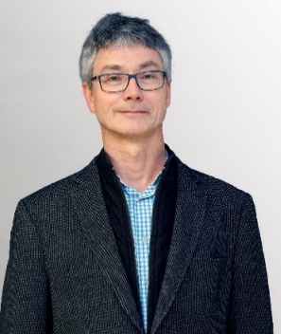
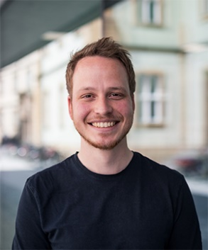
WIAI INTERNATIONAL CENTER
FIRST POINT OF CONTACT REGARDING A SEMESTER ABROAD
mail to: studium-international.wiai@uni-bamberg.de
Prof. Michael Mendler (PhD)
International Affairs Officer
Tim Kipphan, M.A.
Assistant to the International Affairs Officer

Slide 3



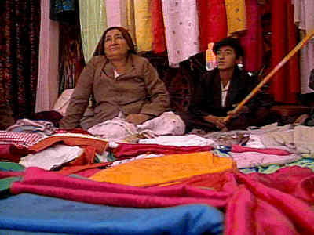
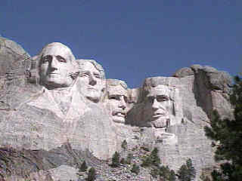

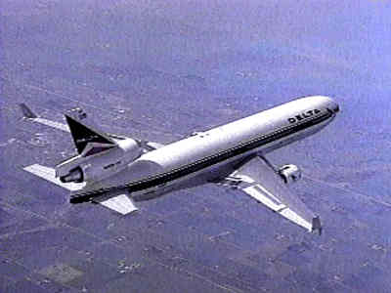

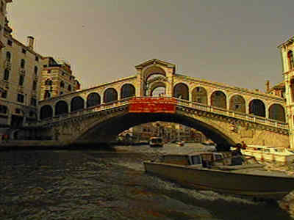
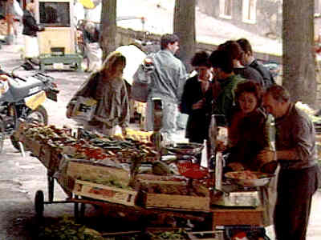
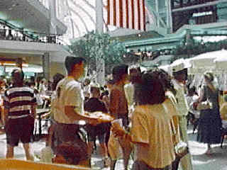

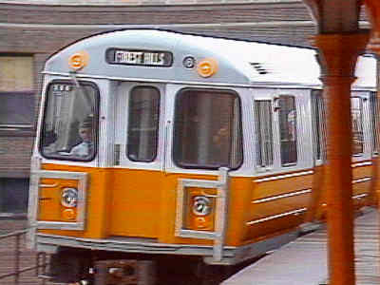
Spending time abroad
During your studies!
Every fourth student in Bamberg spends time studying abroad.
Why not you?

Slide 4
Motivation
prepare for the global professional world
master a foreign language perfectly
do an international internship
experience other cultures, gain additional
perspectives and social competence
make friends abroad, make interesting contacts

Slide 5
Going abroad as a student
International scholarships (e.g. for the USA: Fulbright Commission
Federation of German-American Clubs
DAAD Programmes
ERASMUS+! Bamberg’s Academic International European- and Oversea Programmes from the International Office
→ https://www.uni-bamberg.de/international-office/

Slide 6
International Studies Bamberg
over 300 exchange programmes
60 countries in Europe and Overseas
Application deadline
Europe + Overseas for 26/27:
November 28/11/2025

Slide 7


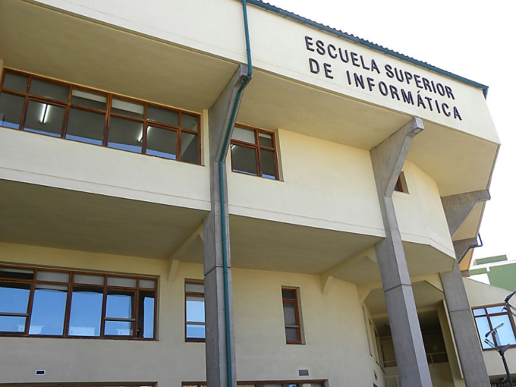

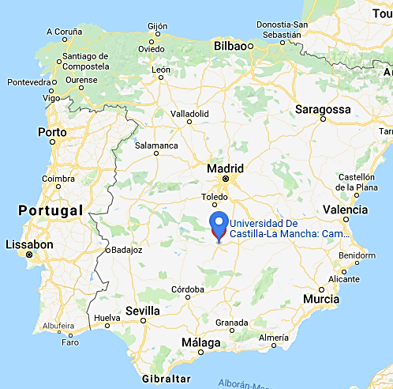

TIP: WIAI Partner Universities - ES

Slide 8
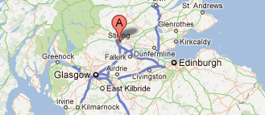





TIP: WIAI Partner Universities - GB

Slide 9

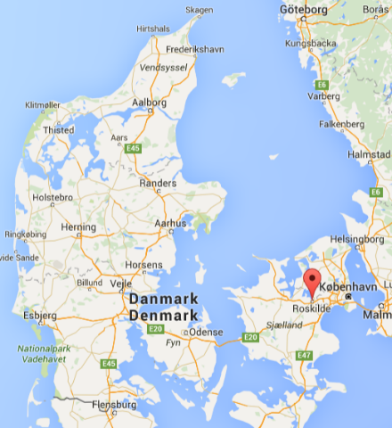

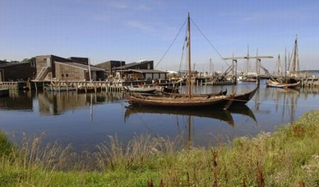
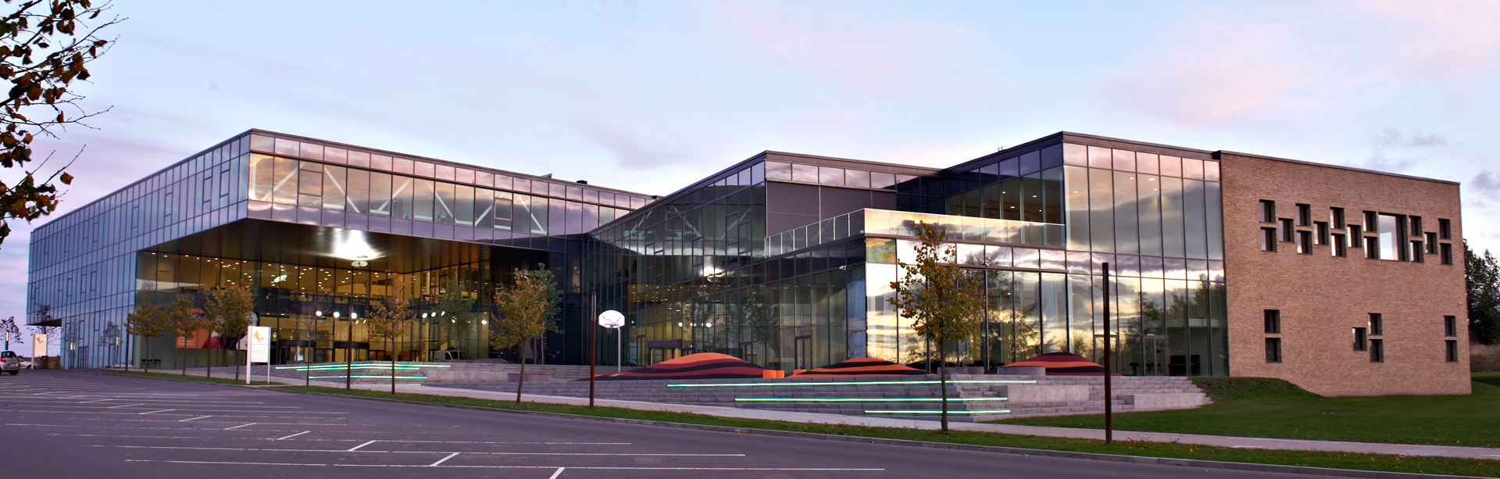
TIP: WIAI Partner Universities - DK

Slide 10

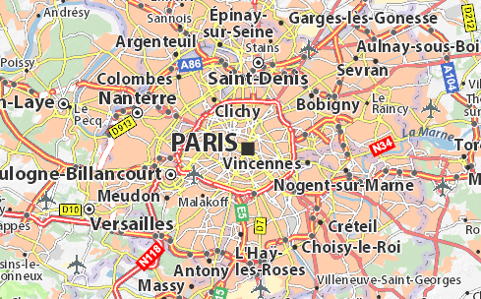
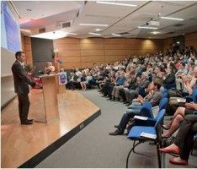

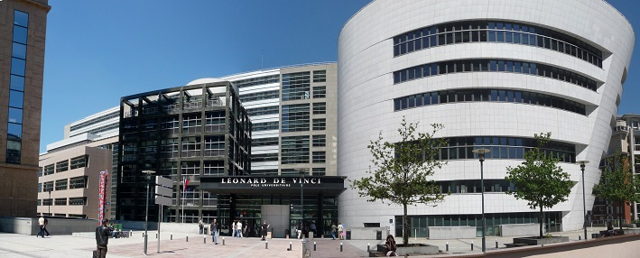
TIP: WIAI Partner Universities - F

Slide 11
Language Courses at the Language Center
Attention: Registration deadlines for foreign
language courses at the Language Centre must not be missed!
Registration deadlines for some courses end
soon!
English for IT (highly recommended!): https://www.uni-bamberg.de/en/sz/about-us/sprachangebot-der-sprachabteilungen/english/technical-language-english/it-english/

Slide 12
Who can advise me?
International Office
  Consulting and information events
  weekly initial consultation appointments during the semester at the AAA
  (via zoom/MS Teams, check website of the international office)
  Application office for exchange programmes
International Representative WIAI
  VC course „Studium International“ pwd: „International“
Career & International Center
  VC course „Jobbörse WIAI “
  Advice on the international internship program
Fachschaft WIAI:
  Info Event „Study Abroad“: TBA (summer term)

