Slide 1
Academic Equal Opportunity Officer of the Faculty WIAI –
german: Gleichstellungsbeauftragte in der Wissenschaft an der Fakultät WIAI –
short: GbWiss WIAI
Prof. Dr. Ute Schmid
Deputies: Prof. Dr. Daniela Nicklas, Prof. Dr. Isolde Adler, Theresa Henn M.A.
WIAI Faculty, University of Bamberg
Room: WE5/02.112, App.: 2867, Mail: wiai.gbwiss@uni-bamberg.de
https://www.uni-bamberg.de/wiai/gbwiss
Notes:
1

Slide 2
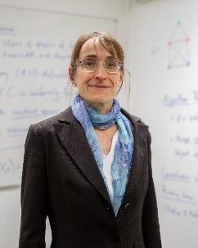
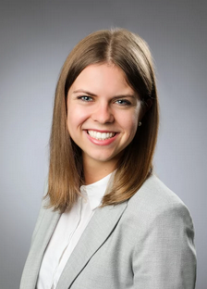
Faculty Equal Opportunity Officer and their team
Academic Equal Opportunity Officer WIAI:
Prof. Dr. Ute Schmid
Deputy Officers:
Prof. Dr. Daniela Nicklas
Prof. Dr. Isolde Adler
Theresa Henn, M.A.
Advisor in the office of the GbWiss WIAI (Gleichstellungsbüro):
Anna Keiderling
Notes:
2

Slide 3
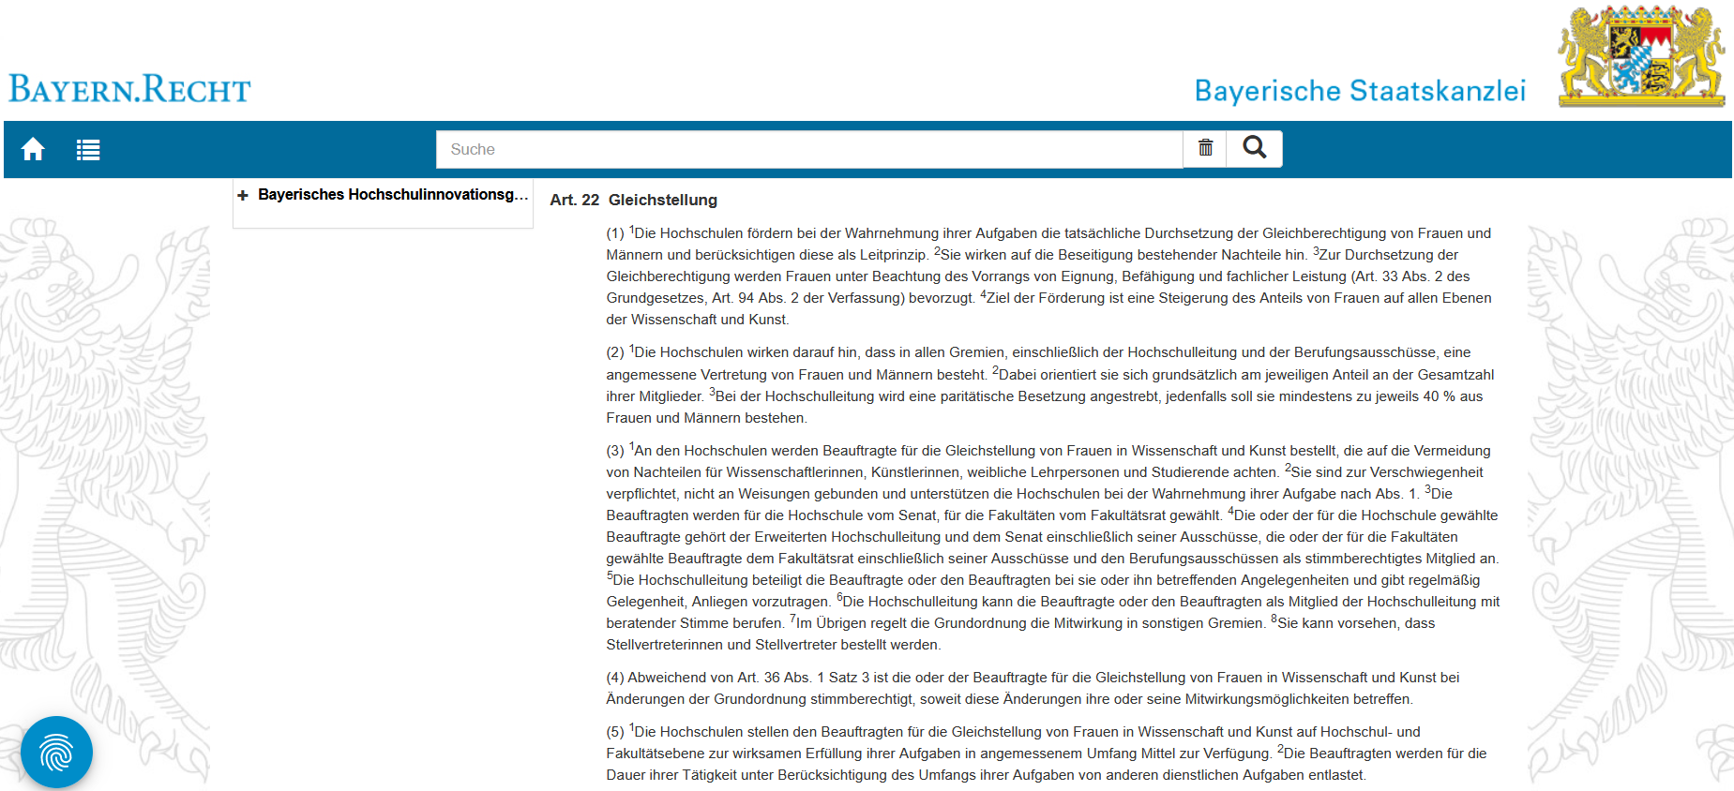
Officers, Equality & Diversity
Regulation according to the Bavarian Higher Education Innovation Act (Bayerisches Hochschulinnovationsgesetz (BayHIG Art 22)):
The promotion of a diverse culture is at the
heart of the work of the
Academic Equal
Opportunity Officer.
https://www.gesetze-bayern.de/Content/Document/BayHIG-22
Notes:
3

Slide 4
Activities overview
Committee Work: Equal Opportunity Advisory Board, Appointments Committee, Project Group „Family Friendly University“, Faculty Council
Promotion of Young People: Mädchen und Technik (MuT), Girls’Day, mentoring program make-IT, Bamberger Informatik Tag (BIT)
Mentoring and Consulting: for students and scientists
WIAI-Women*‘s Network: Excursions, events to exchange ideas and get to know each other, VC-Course, meetings with alumni, etc.
Teaching: Seminar Gender Aspects in Computer Science
Research: ESF-Project Alumnae Tracking, Project Coachnet, PhD, Thesis
Participation: Active networking with national (f.e. GI-Fachgruppe Frauen und Informatik, MINTvernetzt) and European (z.B. EUGAIN) groups
Notes:
4

Slide 5
Promotion of Young People
Mädchen und Technik (MuT) during the fall vacations
Girls‘Day in april
Bamberger Informatik Tag (BIT): Open Faculty Day in spring or early summer
make-IT Computer Science Mentoring annually from October to July
We are always happy to have students involved!
Notes:
5

Slide 6
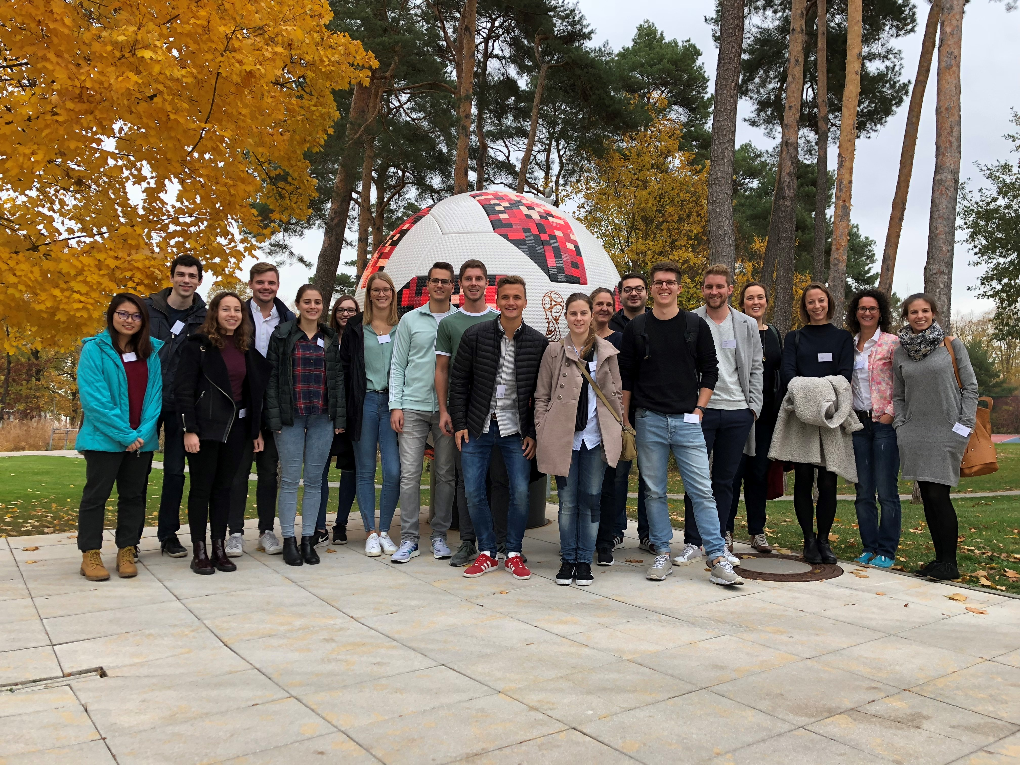
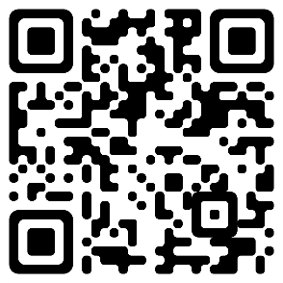
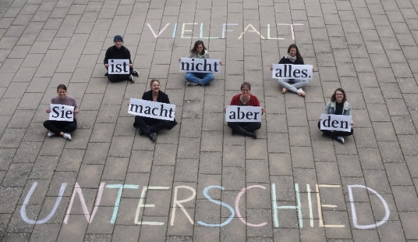
WIAI-Women*‘s Network for EVERYONE
Excursions:
next excursion planed for 2025
VC-Course: Frauen@WIAI
Information on events, scholarships, etc.
job advertisements
more upcoming events and offers this semester
Website: Videos, CVs, literature, link tips, events
Consulting: on all gender-specific topics and questions about studying and university life
follow in Instagram: gleichstellungsbuero_wiai
Come and visit us, we are always there to listen to you!
enroll directly
Notes:
6

Slide 7
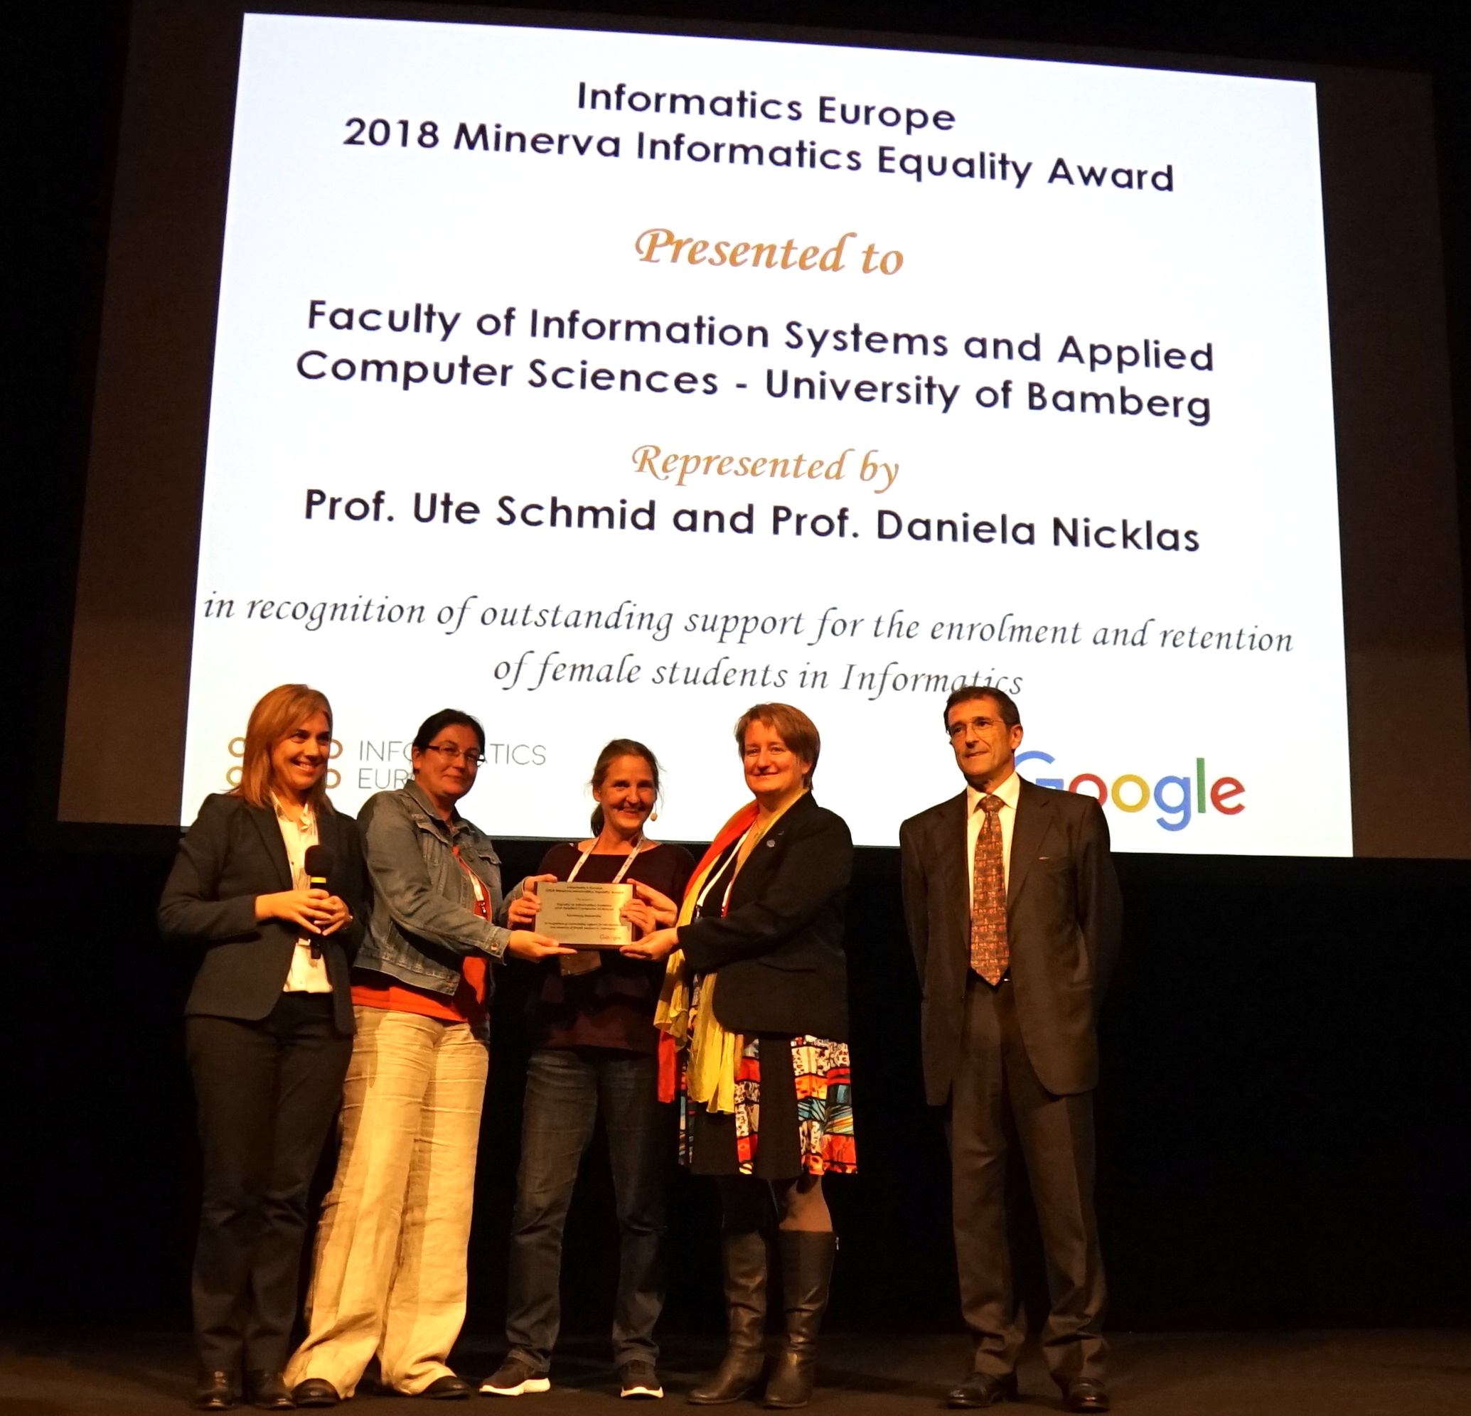
We are award-winning!
Notes:
7

Slide 8
We wish you a
GOOD START
to your studies!
WE5/02.112 | ref-gbwiss.wiai@uni-bamberg.de wiai.gbwiss@uni-bamberg.de | https://www.uni-bamberg.de/wiai/gbwiss | gleichstellungsbuero_wiai
Notes:
8

