Slide 1

Erstsemestereinführungstage |
First Semester Introductory Days
Summer Semester 2025
14th to 17th April
Information Systems and Applied Computer Sciences Faculty
Notes:
Begrüßung
Vorstellung
Rückblick
Einleitung Dozenten

Slide 2






Fachschaft WIAI – The Student Council
Who are we?
students, just like you!
7 elected representatives and a magnificent community of devoted procrastinators
not to forget: Fooboar, our mascot
14.04.2025

Slide 3


Fachschaft WIAI – The Student Council
What do we do?
We welcome new students (aka you) to the faculty.
We provide Mate (and helpful advice) to take on any problems regarding your studies.
We represent your interests in a range of university committees.
We organize a collection of events (Summer Barbecue, Christmas Party, regulars‘ table).
We offer independent workshops (LaTeX, Linux, …).
We provide (more or less) useful services for your studies (suche.wiai.de, …).
Our goal is to make your time in Bamberg as enjoyable as possible.
14.04.2025

Slide 4


Fachschaft WIAI – The Student Council
LaTeX Workshop
weekend seminar about the LaTeX typesetting system
widespread in academic writing
our recommendation for all seminar papers
Date: May 16th and 17th
detailed information can be found on the registration page: wiai.de/latex
08.10.2024

Slide 5
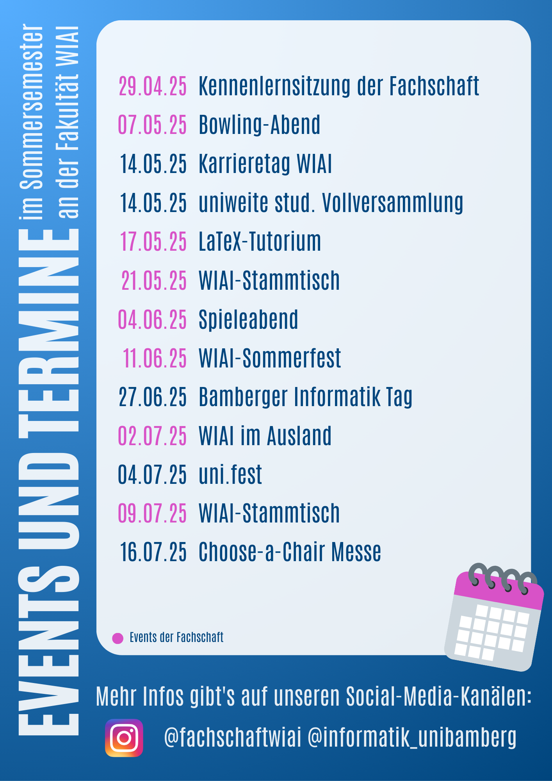



More events this summer
from Fachschaft WIAI, faculty WIAI and many more
even more events
LaTeX-Workshop
Bowling Night
Regulars‘ Table by Fachschaft WIAI
„Choose-a-chair“ Fair
WIAI summer party
Games Night
and many more!
14.04.2025
Notes:
Kommende Veranstaltungen

Slide 6







Fachschaft WIAI – The Student Council
Where can you find us?
WE5/02.104 (on the second floor, next to the small staircase)
fachschaft-wiai.stuve@uni-bamberg.de
+49 951 863-1219
www.uni-bamberg.de/wiai/fs
@fachschaftwiai
@fachschaftwiai
Join us at our introductory meeting on April 29th, 6:15 p.m. (WE5/01.006)!
We are always looking for fellow procrastinators.
14.04.2025

Slide 7
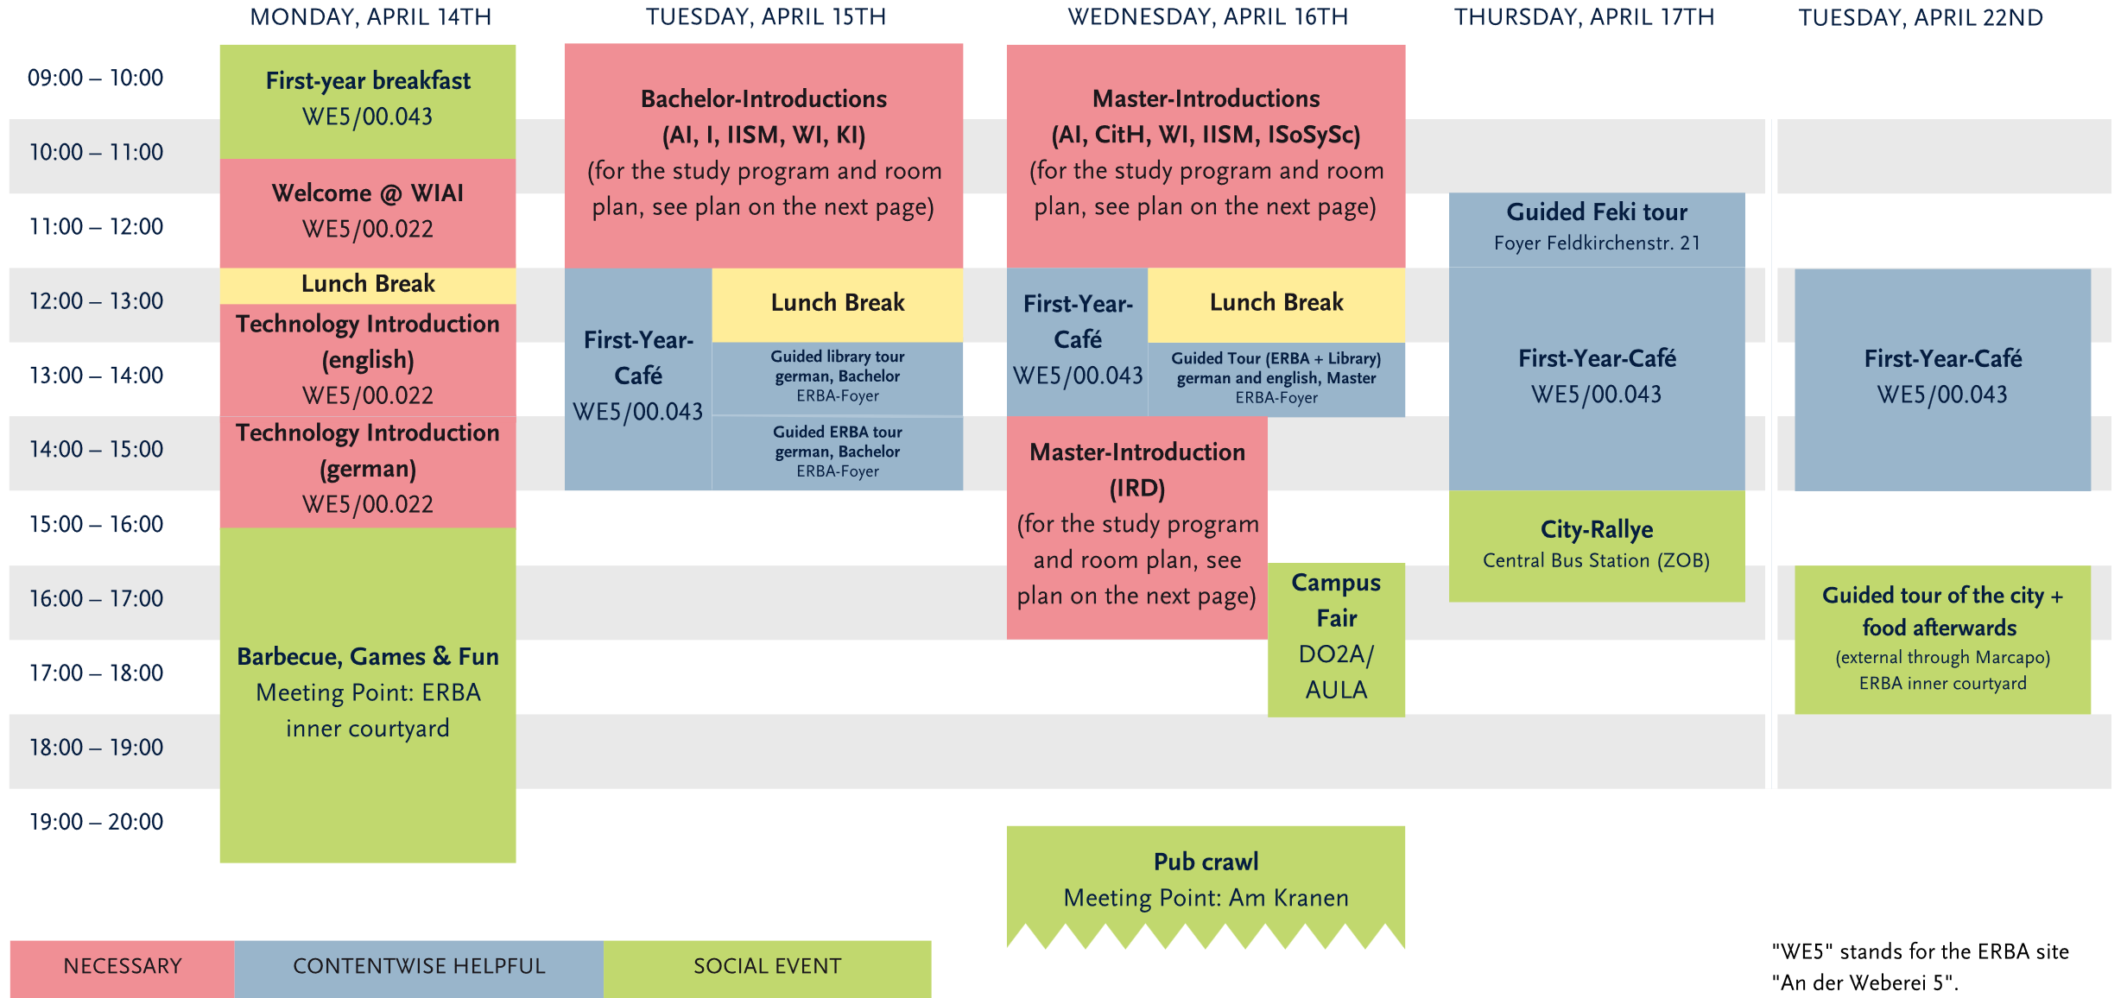
Upcoming events in the next days
from Fachschaft WIAI and other student groups
14.04.2025
Notes:
Kommende Veranstaltungen

Slide 8
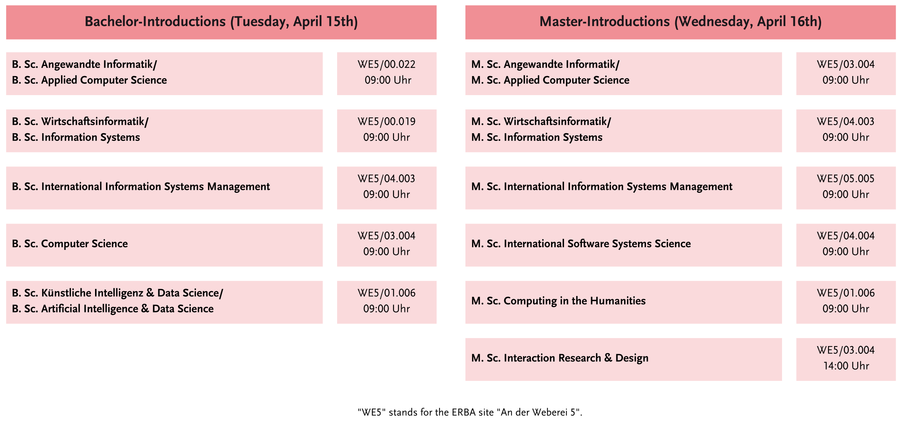
Upcoming events in the next days
from Fachschaft WIAI and other student groups
14.04.2025
Notes:
Kommende Veranstaltungen

Slide 9

Upcoming events in the near future
from Fachschaft WIAI and other student groups
Upcoming events:
Partycipate (Party after „Kneipentour“), 16.04. @ Live-Club
Student Council Introductory Meeting, 29.04., 6:15 p.m. @ WE5/01.006
Bowling Night, 07.05. @ Bowlinghaus Bamberg
WIAI Career Day, 24.05.
Regulars‘ table (by feki.de), beginning of the semester @ various bars
‒
14.04.2025
Notes:
Kommende Veranstaltungen

Slide 10

Fachschaft WIAI – The Student Council
Thanks to our tutors and helpers!
Lydia
Laetitia
Theresa
Janne
Florian
Jochen
Tobias
Josi
Paul Hannah
Sandra
Jessi
Niko
Laura
Noah
Clara
Fiona
Tobias
Kevin
Source: https://xkcd.com/1543/
14.04.2025

