Slide 1

Introductory Days @ WIAI
Winter term 2025/2026
Notes:
Hinweis:
Anpassen der Fußzeile: Die PowerPoint-Vorlagen weisen alle eine Fußzeile auf, die sich natürlich individuell anpassen lässt. Um z.B. den Titel des Vortrages und den Namen des Referenten einzutragen muss dazu der Hauptfolienmaster geändert werden. In PowerPoint 2007/2010 muss man dazu unter dem Menü-Punkt "Ansicht" den Button "Folienmaster" anklicken. Am linken Bildschirmrand wird dann die Liste der Masterfolien angezeigt. Der oberste ist der Hauptmaster in dem sich die Textfelder der Fußzeile problemlos ändern lassen.

Slide 2

Degree-Introduction
Knowledge of the legal basis of the degree programme, deadlines and the various
module groups
Continue with: general information about exams, university and university-life as well as timetable creation

Slide 3


Short Break :)
    We upload this presentation to the EET-VC course. So you don't necessarily have to take notes :)
    A lot of information from this presentation and much more can be found on the EET-Website, for reading the detailed information again afterwards.
Fooboar-Tip:
Use the break to talk. The students to your left and right will certainly want to meet new people, too!

Slide 4

Important terms, deadlines and information
erstellt mit DALL-E 3

Slide 5
Examinations
Grading 1,0 / 1,3 / 1,7 / … / 4,0
At 5.0 you have failed
Second attempt Failed exams can be repeated as often as desired until the maximum duration of study is reached.
    Registration deadlines for examinations are binding
    (same for de-registration).

Slide 6
Examinations
Compulsory registration? There is no compulsory registration for (failed) exams. → register yourself!
Improvement? Passed exams cannot be repeated.
Illness in case of illness, a medical certificate must be submitted to the examination office, otherwise the exam is considered a failed attempt.

Slide 7
General deadlines and dates
Re-registration Each semester, the semester fee (118.60€) must be transferred for re-registration for the next semester.
Semester fee Studentenwerk fees & Semester public transport pass for bus and train in the district of Bamberg (with student ID)
deadline summer 2026:
12.01.26 – 30.01.26

Slide 8
General deadlines and dates
University Sports the bookings usually take place before the start of the semester and many sports are full very quickly.
Course Registration for some courses, especially language courses, a speedy registration is expected. (first registration
deadlines for languages did end on 05.10.2025)
for winter 2025/26:
02.10.25, 11am

Slide 9
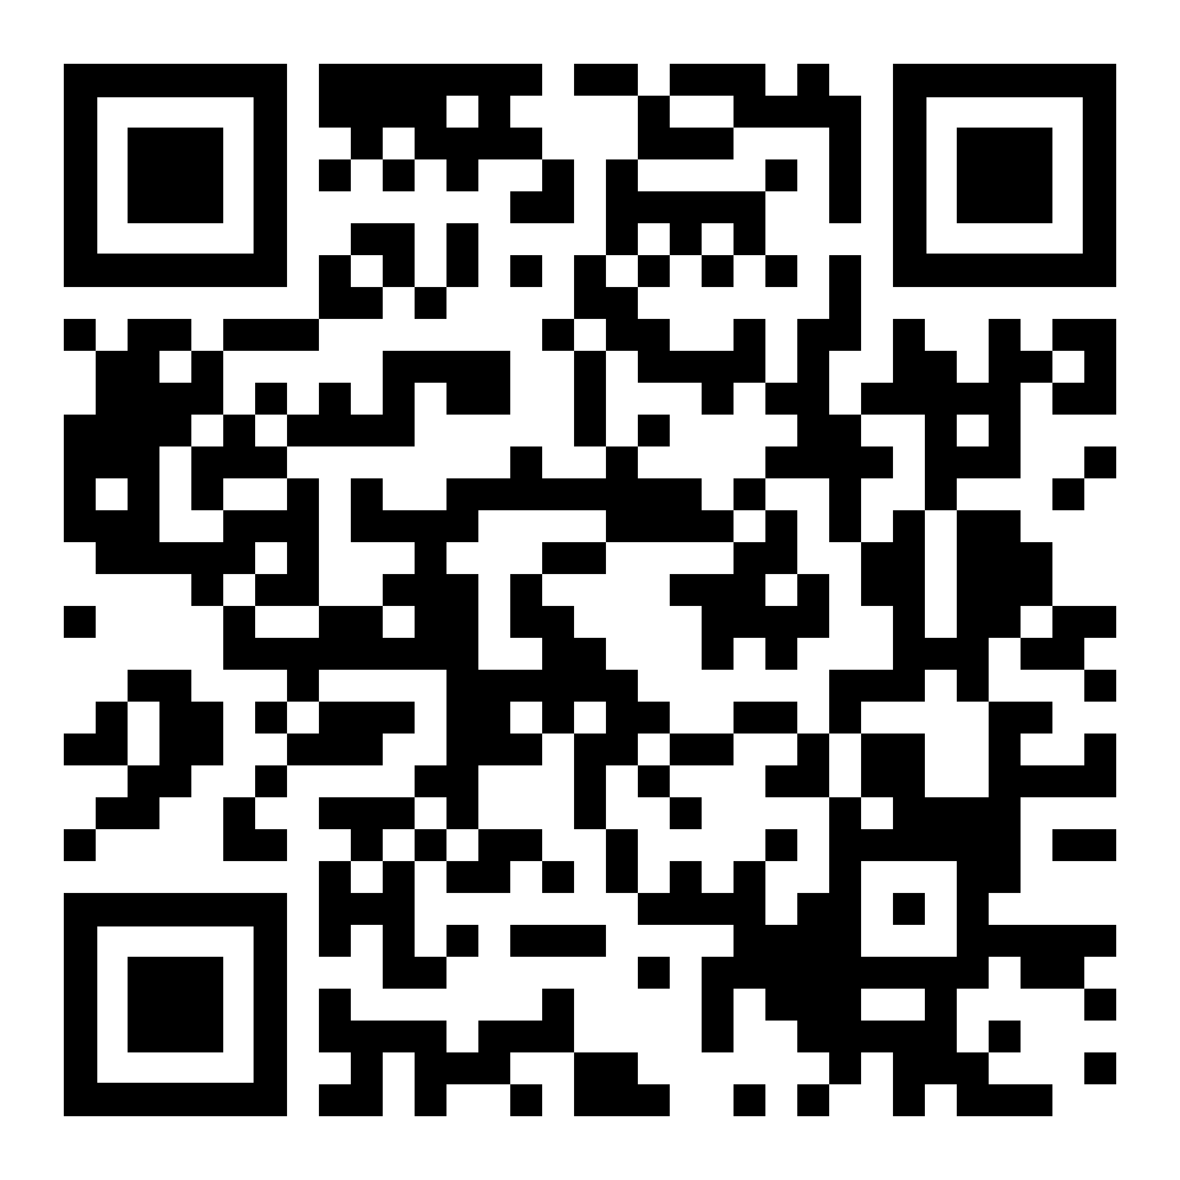
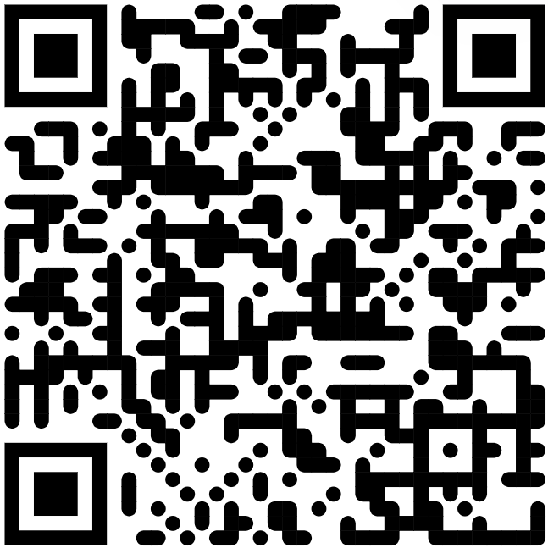
Repetition – key IT services
WiFi
eduroam, BayernWLAN
eMail
Office 365, mailex
https://www.uni-bamberg.de/its/anleitungen/
https://www.uni-bamberg.de/its/
dienstleistungen/mail/studium/o365/

Slide 10

Useful university websites
https://stuve- bamberg.de/kurzlinks/
qis.uni-bamberg.de Certificates of enrolment
flexnow.uni-bamberg.de Exam and course registration, exam results, grade sheet
univis.uni-bamberg.de Directory of module dates, rooms and persons
vc.uni-bamberg.de eLearning platform for all modules
katalog.ub.uni-bamberg.de Catalogue of the University Library
uni-bamberg.de/wiai Information about the chairs of the faculty

Slide 11
Other relevant university groups and contact points
stuve-bamberg.de Your student representation!
feki.de here you can find information about everything about the university. From the happy hour guide, to job offers and information on other university groups.
wiai.de Information about your faculty from your student council and alumni!

Slide 12

Student Council WIAI and Events
erstellt mit DALL-E 3

Slide 13
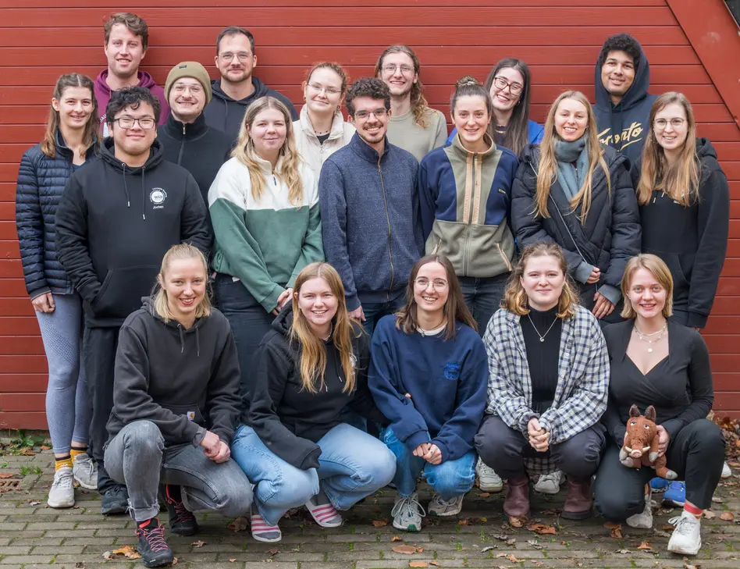
Fachschaft WIAI
Your student representation of WIAI
The students you can contact for questions or problems during your studies and responsible for events such as the summer party, LaTeX tutorial and much more!
Follow us for all the latest info :)

Slide 14


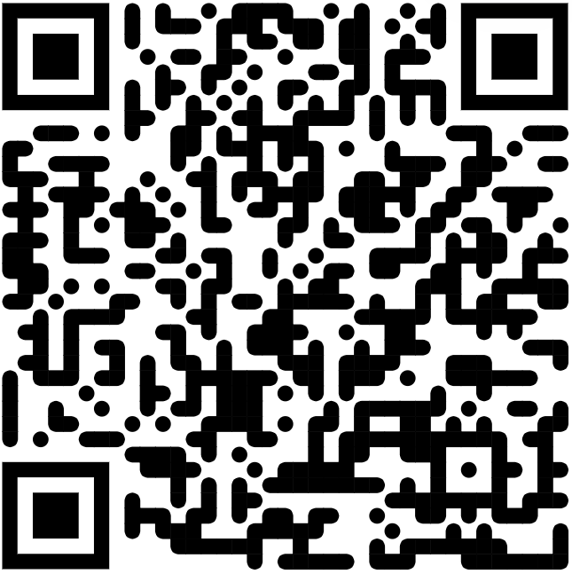
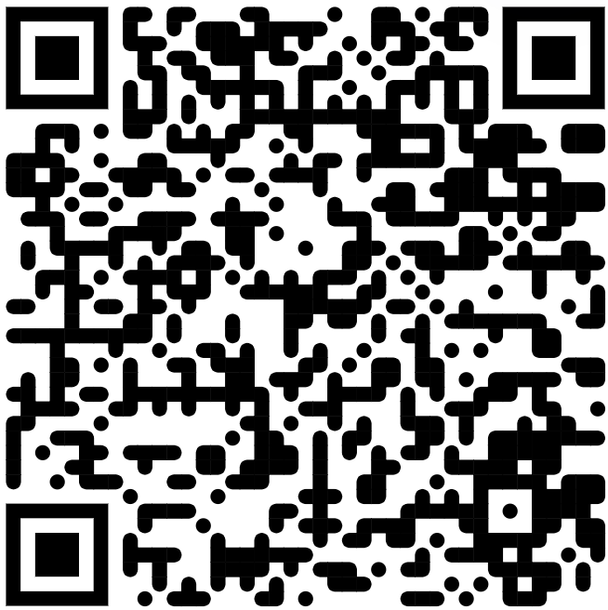
Fachschaft WIAI
@fachschaftwiai
@fachschaftwiai@kif.rocks

Slide 15
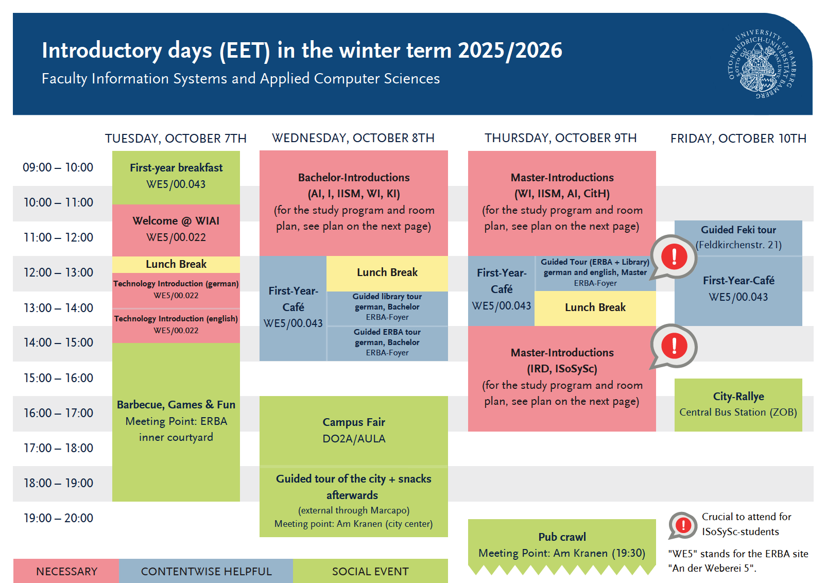
What's next?

Slide 16
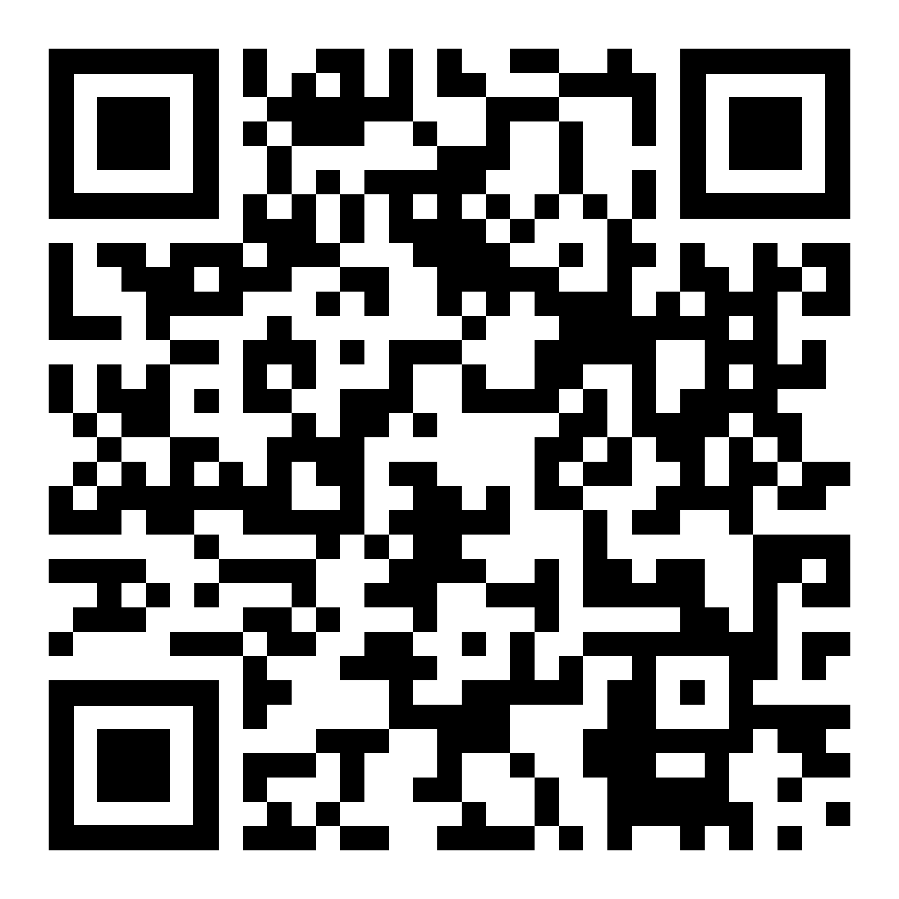
Registration for the Pub Crawl
Just scan the QR-Code or register on the
EET-website
(uni-bamberg.de/eet/
zeitplan/wiai)

Slide 17
What‘s next?
Title | Date
Partycipate (Party after Pub Crawl) | 09.10. @ Live-Club
Get-to-know-evening (FS WIAI) First-year session (FS WIAI) | 22.10. 6 pm c.t. @WE5/01.006 11.11. 6 pm c.t. @WE5/01.006
WIAI regulars‘ tables (FS WIAI) | 05.11 17.12 @ the Christmas market 14.01
Details can be found on our Website or on Social Media.

Slide 18

Timetable- creation
erstellt mit DALL-E 3

Slide 19
University events and timetable creation
General Examination Regulations
(„allgemeine Prüfungsordnung“)
Examination regulations for the entire faculty WIAI
Basic framework conditions of the study programme
Study and Exam-ination Regulations
(„Studien- und Fachprüfungsordnung“)
Course-specific regulations such as duration of study, stay abroad, modules to be taken and learning objectives
Module Handbook
(„Modulhandbuch“)
Exact breakdown of the modules to be taken
Most frequently needed to plan your studies

Slide 20
Typical types of events
Lecture
Biggest event
Mostly with the Professor himself
Exercise
Applying the theory from the lecture
Tutorial
No new content
Student tutor
answers questions
and you work
on additional
exercises
Teaching the theory
Often in smaller groups
New, more practical content also possible

Slide 21
University events and timetable creation
At the university you are not given any timetables, you can choose your own module.
For orientation, you will find sample timetables for this semester in the freshman brochures for many degrees.
    Caution: Events usually take place "c.t.". "14 o'clock" means, for example, that the start is at 14:15. (Opposite: "s.t.": 2 pm = 2:00 pm)

Slide 22
Timetable creation – hands-on!
No
Select modules from module handbook
Add courses to timetable in UnivIS
justifiable
overlaps?
Yes
If necessary, register via FlexNow2, website or by
e-mail
Join
VC Course
Pay attention to study progress monitoring!
Notes:
Hier springen in Hands-on-demo – anhand eines Beispiels univis, flexnow und den VC erklären → Stichpunkte siehe Tutorien-Skript

Slide 23
Important VC courses – join now!
„Aktuelle Informationen der Fachschaft WIAI“
Course of your own course of study
Course of the respective examination board
„WIAI Information about Projects and Seminar Registration“
„WIAI.community“
„Jobbörse WIAI“ → Subscribe to relevant forums yourself
„Frauennetzwerk der Fakultät WIAI“

Slide 24
So, off to the lunch break!
46 FC 72 20 77 61 73 20 62 65 73 75 63 68 73 74 20 64 75 20 6E 6F 63 68 20 64 69 65 20 45 45 54 73 2C 20 77 65 6E 6E 20 64 75 20 64 61 73 20 68 69 65 72 20 65 68 20 73 63 68 6F 6E 20 6C 65 73 65 6E 20 6B 61 6E 6E 73 74 3F 21 3F 20 77 65 20 2764 20 66 6F 6F 62 6F 61 72

